Slide 1
British values

Slide 2
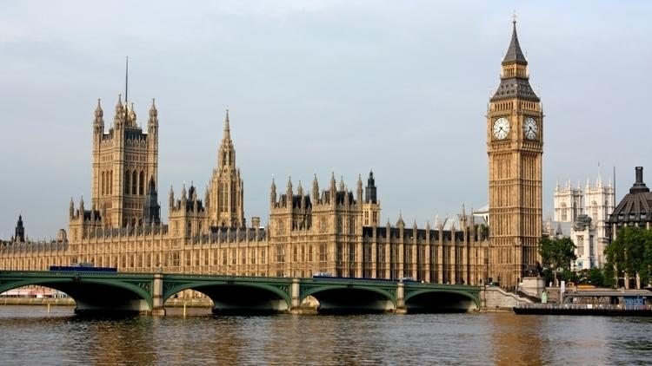
What are British values?
Democracy
The rule of law
Tolerance
Individual liberty
Mutual respect

Slide 3
So what do these mean?

Slide 4
Democracy
Democracy is where everybody has a say in what goes on in an organization
A good example of a democracy Is a general election. Everyone above the age of 18 in the UK has the right to vote which means they have a say in who is elected.
Can you think of any examples of democracy in the school?

Slide 5
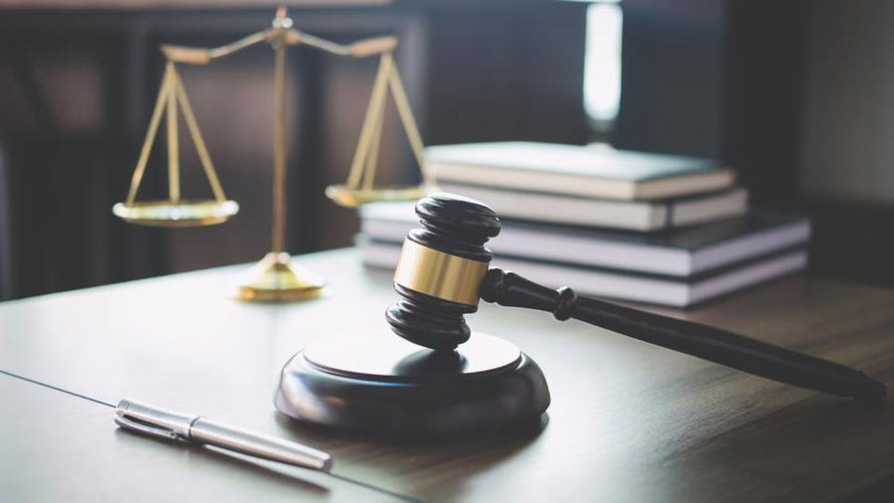
Rule of law
These are a set of rules we have to abide by
Laws are set by the government and apply to the whole country
If you do not follow the law, there will be consequences such as fines to pay or time to serve in jail
What are the school rules you follow?

Slide 6
Individual liberty
Another term used is freedom
Most commonly found when we talk about freedom of speech and freedom of choice
What have you chosen to eat this morning?

Slide 7
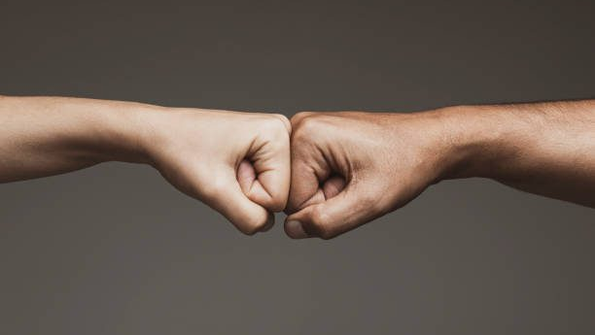
Mutual respect
This is the idea that we much respect one-another regardless of our differences
Listen and appreciate what someone else has to say
Be kind and supportive
Can you think of a time when someone supported you? In sport?

Slide 8
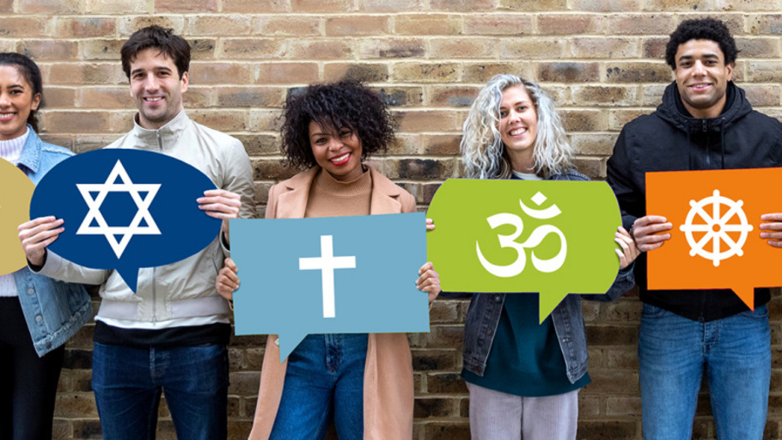
Tolerance
We accept and respect everyone’s differences, religion, belief’s, faiths
what someone believes does not change the way in which we treat them
What do you believe in?

