Slide 1
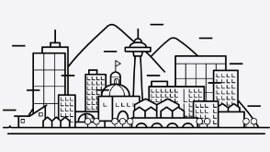
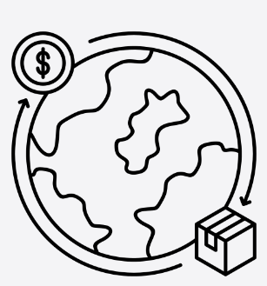
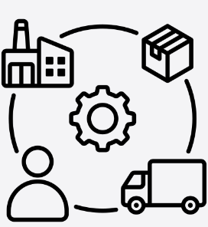
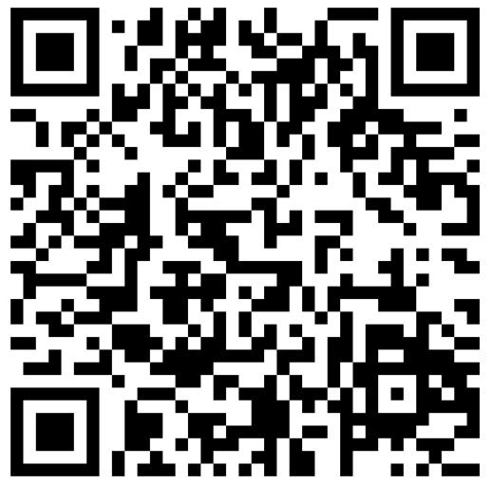
Year 6 – Cities of Industry
What characteristics UK cities have and how they change over time.
What are we learning?
Lesson 1 A city must have a cathedral and university Locate some cities (16 compass points) List the physical features of a city and why the city has developed where it has. Use an atlas to identify where cities are in the UK. Learn where cities are in relation to other cities. Use the points of the compass to explain for example where Manchester is in relation to Liverpool. | Lesson 2 Locate key cities on a map Know the populations of cities Know the common human features often found in cities. Human features are things like houses, roads and bridges. They have been built by people. List questions you would want to find out about a chosen city. | Lesson 3 Using digimaps looking at how a city looked in the 1890’s and then the 1950’s compared to how it is looking now .Look at what features were visible on the old map of London. Rivers, Castles, parks etc what is there now and why?
Lesson 4 A clear definition of trade – to buy and sell goods and services we want and need. It is the exchange of goods (or services) in return for other goods, services or money. Even in the Stone Ages, goods were traded but on a very local scale. Now, globalisation has occurred – world’s countries have become more connected as a result of international trade | Lesson 5 Know that there are different stages of a supply chain, Three stages of production (primary, secondary, tertiary).Understand that there are many job roles and countries involved in a global supply chain Know that countries lower down the supply chain are usually less wealthy countries | Lesson 6 The most common products traded by Britain are cars, generators and medicines. The UK’s top trading partners are US, Germany, Ireland and Netherlands. That products are imported/exported by countries based on their human and physical features.
HOW DO WE HELP PREVENT CLIMATE CHNGE?
.
To find out more
Vocabulary
Field Work
local | neighbourhood
regional | Area, district around you
global | Relationships around the global where trade my occur
city | A large town
urban | Built up area
rural | countryside
trade | Exchange of goods or sevices
Supply chain | Production and distribution of something
Trade partners | a person, organization, or country with whom somebody customarily does business.
River Park. Leave at 10am and walk to the Dell and have lunch. Continue to walk to River Park. Take the children up on to the hill and discuss what they can see looking towards Liverpool. Discuss the features of a city, sketch the skyline. Look towards Snowdonia and compare the difference between the view of Liverpool. Sketch the skyline of Snowdonia.

