Slide 1
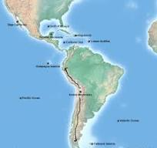
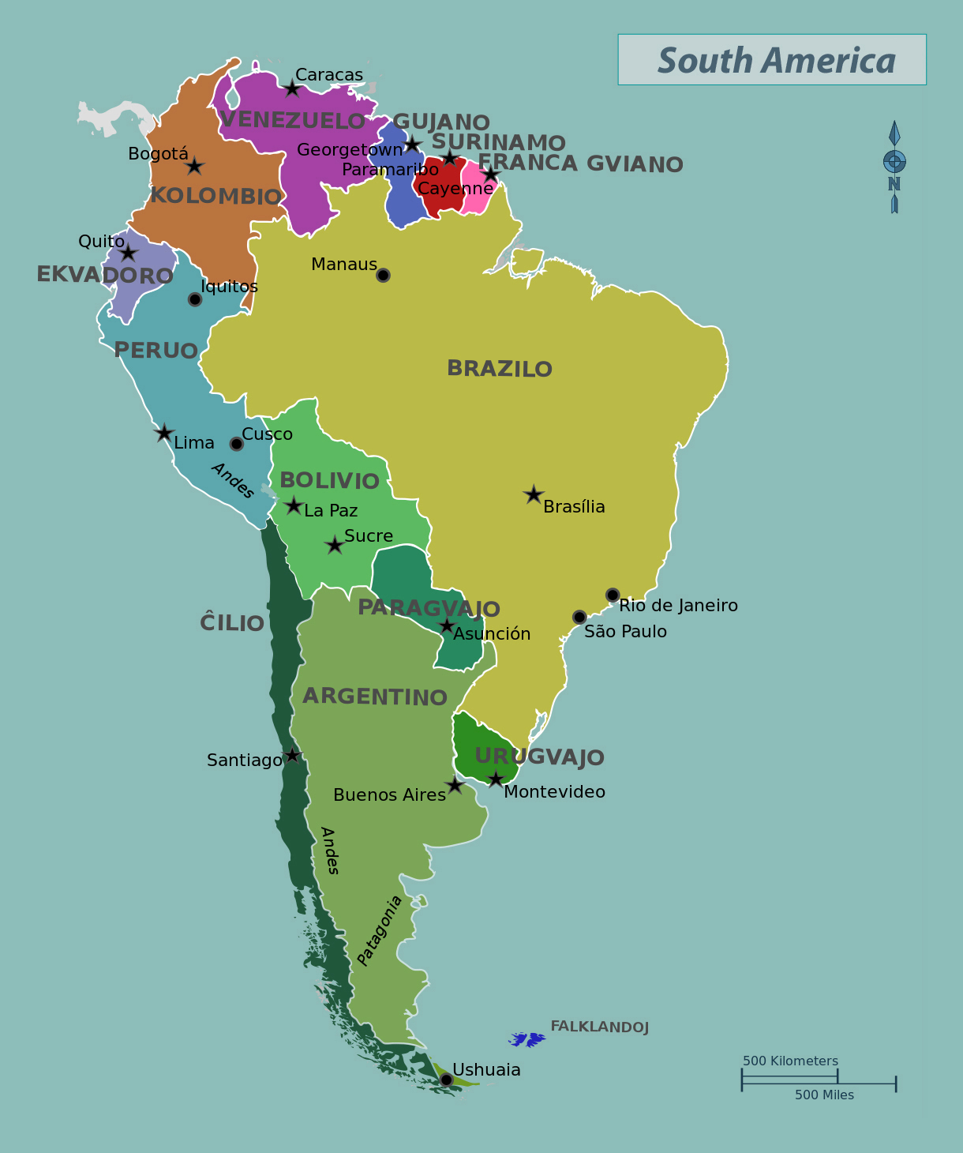
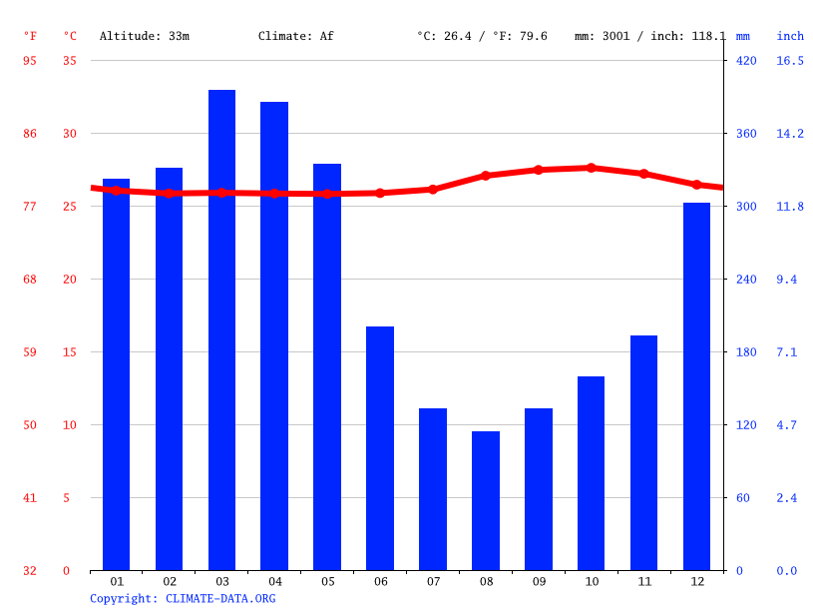



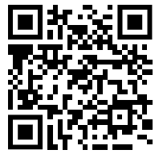
Year 5 – South America (Brazil)
Where is South America in relation to the UK
What are we learning ?
Lesson 1 s South America is a continent and has several countries within it. It is surrounded by the Atlantic Ocean on the east coast and the Pacific Ocean on the west coast. The Caribean Sea is situated to the north. | Lesson 2 South America consists of 12 countries—Chile, Argentina, Uruguay, Paraguay, Bolivia, Peru, Ecuador, Brazil, Colombia, Venezuela, Guyana, and Suriname—plus an overseas department of France called French Guiana. This list shows the country and its capital city: Buenos Aires = Argentina La Paz = Bolivia, Brasilia = Brazil. Santiago = Chile, Bogota = Colombia. Quito = Ecuador,Georgetown = Guyana, Asuncion = Paraguay. | Lesson 3 Manaus has a tropical monsoon climate with consistently high temperatures throughout the year and intense rainfall from October through to June. It has a maritime climate with four distinct seasons. Average annual temperature varies between 4.5 °C in winter to 14 °C in summer with warmer conditions in the South.
Lesson 4 Physical features are Human and physical features are things that you can see all around you. Physical features like seas, mountains and rivers are natural. Human features are things made or built by humans like cities, houses, roads, bridges, ports, farms, factories, language, political systems and religion. | Lesson 5 Rio de Janeiro is a city of two halves. Rich and poor living side by side. Favela in Brazil, a slum or shantytown located within or on the outskirts of the country's large cities, especially Rio de Janeiro and São Paulo. A favela typically comes into being when squatters occupy vacant land at the edge of a city and construct shanties of salvaged or stolen materials. | Lesson 6 Features of a Favela - Low-rise, high density development. Pedestrian orientation. High use of bicycles & public transportation. Mixed use (homes above shops) Life in the UK is different we have designated shopping and residential areas. Parks and education establishments
HOW DO WE HELP PREVENT CLIMATE CHNGE?
.
Vocabulary
Vocabulary
Rainfall | Rain is the liquid form of water that falls from the sky in drops. Cyclones and other storms can bring heavy rains. Rain fills lakes, ponds, rivers, and streams ...
Average | An Average is created by adding the temperatures together and divide by how many temperatures there are.
Temperature | Temperature is how much heat is in something, and you experience it every day.
Climate | The weather found in a certain place over a long period of time is known as the climate.
Favela | favela, in Brazil, a slum or shantytown located within or on the outskirts of the country's large cities, especially Rio de Janeiro and São Paulo.
Pedestrian Area | A person who is walking in a walking area only

