Slide 1
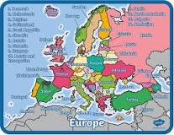
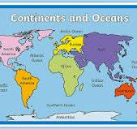
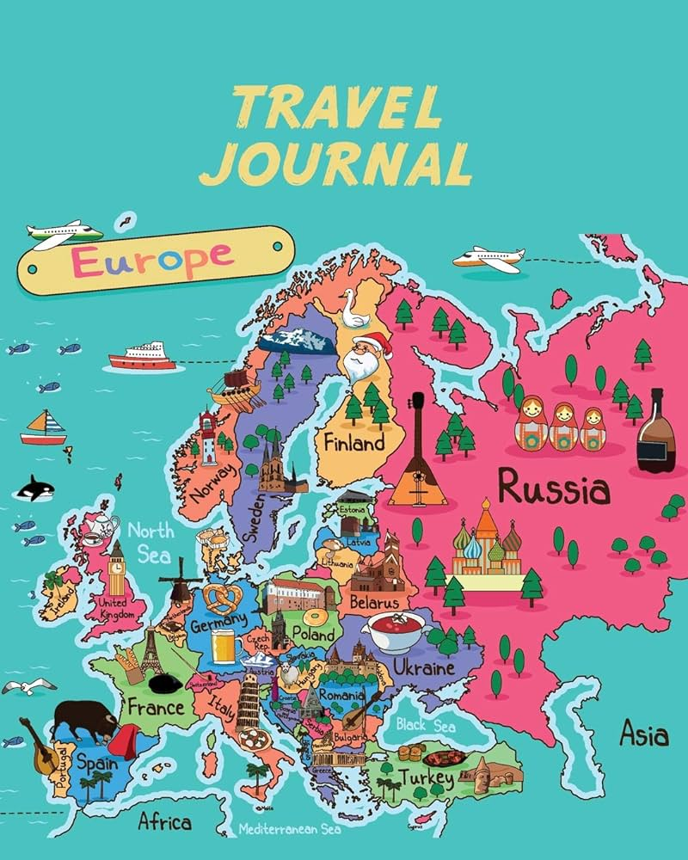
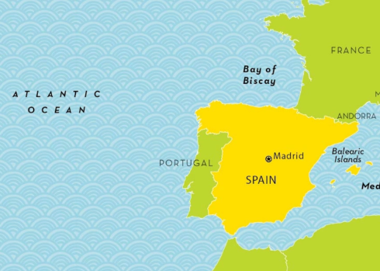
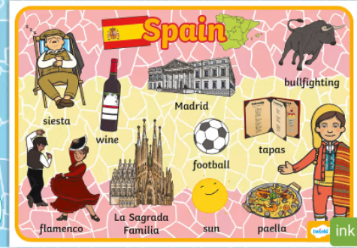
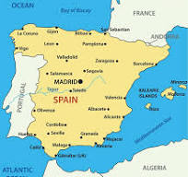
Year 4 – European Study - Europe
How do other European countries compare to the UK?
What are we learning ?
Lesson 1 Europe is the western peninsula of the giant "supercontinent" of Eurasia. European union (EU) is an organization made up of 27 countries of Europe. Brexit is a word made up to describe the “British Exit“ from the European Union (EU). In a vote on June 23, 2016, more than half of the people of the United | Lesson 2 Europe is bordered by the Arctic Ocean to the north, the Atlantic Ocean to the west, and the Mediterranean, Black, and Caspian Seas to the south. There are 50 countries in Europe. United kingdom, France Germany Spain, Belgian, Austria, Italy, Sweden, Denmark, Greece and Portual are a few of them. | Lesson 3 From the east coast of the uk I cross the North sea to arrive in Norway or the Netherlands. From the south of England I cross the English Channel to arrive in France. From the west coast of the UK I would cross the Irish Sea to arrive in Ireland.
Lesson 4 OFFICIAL NAME: Kingdom of Spain. FORM OF GOVERNMENT: Parliamentary monarchy. CAPITAL: Madrid. POPULATION: 47, 909, 753. OFFICIAL LANGUAGES: Spanish, Catalan, Galician, Basque. MONEY: Euro. AREA: 505,988 square kilometres. MAJOR MOUNTAIN RANGES: Pyrenees, Sierra de Guadarrama, Sierra de Gredos, Sierra Nevada. | Lesson 5 To the east lies the Mediterranean Sea, including Spain's Balearic Islands. Spain also rules two cities in North Africa and the Canary Islands in the Atlantic. The interior of Spain is a high, dry plateau surrounded and crisscrossed by mountain ranges. Rivers run to the coasts, creating good farmland. Average rainfall is Spain has an average rainfall of around 650mm (25.6 inches) per year, although this can vary quite a bit depending on where you are in the country The summer months are very hot with temperatures regularly in excess of 35 °C. Madrid for example sees an average daily maximum of 33.5 | Lesson 6 Physical Features The only desert in Europe can be found in Almeria, Spain. Spain has a large variety of landscapes, including snowy mountains, cliffs and sandy beaches. The main religion in Spain is Christianity. Since joining the European Union in 1986, Spain has used the Euro as currency. Human Features Spain has a vibrant and warm culture. The people are passionate, expressive, and loving. They prioritise family and make time to enjoy the company of their loved ones, especially over food. They live to enjoy life and that's why they take things slowly.
HOW DO WE HELP PREVENT CLIMATE CHNGE?
.
Vocabulary
Climate | Landmarks are features or structures around the world that are easily recognised or unique.
physical features, | Human and physical features are things that you can see all around you. Physical features like seas, mountains and rivers are natural.
landmarks, | Landmarks are features or structures around the world that are easily recognised or unique.
Human Features | Human features are things like houses, roads and bridges. They have been built by people.
Population | Population is the number of people living in a certain place.
Landmarks | Landmarks are features or structures around the world that are easily recognised or unique.

