Slide 1
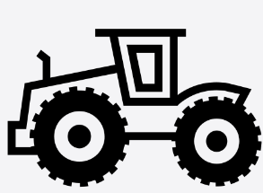
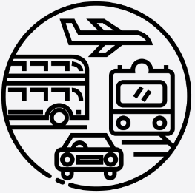
Year 6 - Interconnectivity
Lesson 1 China is located in Asia UK is located in Europe Dubai is trans-continental – located across Asia and Africa Countries that share a land border with the UK (the Republic of Ireland), Countries that share a land border with China (Afghanistan, Bhutan, India, Kazakhstan, North Korea, Kyrgyzstan, Laos, Mongolia, Nepal, Pakistan, Russia, Tajikistan & Vietnam, Burma) Countries that share a land border with Dubai (Oman, Qatar, and Saudi Arabia) | Lesson 2 Field work is the process of observing and collecting data about people, cultures, and natural environments Our questions need to be relevant and easy to collect data Our end goal is to understand the physical and human features of the UAE and China | Lesson 3 Transportation links between China, UAE and UK are vital for trade opportunities Transportation links between China, UAE and UK are also important for travel purposes (people like to travel between these countries for work and holiday) Transportation links between these countries have been made quicker and easier to enable better trade opportunities
Lesson 4 UAE has the smallest population and economy out of the three countries China has the largest population and economy out of the three countries UAE’s population and economy has grown due to tourism and increased trade | Lesson 5 An increased population means more factories, more transport and therefore more air pollution. China has a high, and sometimes dangerous level of air pollution. The UK and UAE still have problems with their air quality but not as severe as China. All countries have introduced various initiatives to try to help the air pollution problem | Lesson 6 The most common products traded by Britain The UK’s top trading partners That products are imported/exported by countries based on their human and physical features
HOW DO WE HELP PREVENT CLIMATE CHNGE?
.
How do we help prevent pollution?
Vocabulary
Urbanisation | the process of making an area more urban.
globalisation | the process by which the world is becoming increasingly interconnected as a result of massively increased trade and cultural exchange.
Manufacture | the production of goods through the use of labour, machinery, tools and biological or chemical processing or formulation.
Distribution | the way something is spread out or arranged over a specific geographic area
consumer | organisms that feed on plants or other animals for energy.
Supplier | a person, company, or organization that sells or supplies something such as goods or equipment to customers.
Raw material | substances that are either available naturally (like wood, ores, etc.) or produced by farmers, herders,
Save energy at home and in school
Walk, cycle or take public transport
Throw away less food – eat your leftovers!
Reduce, reuse, repair and recycle
Eat less meat and more vegetables
Support local causes and movements
Talk to others about the changes you make

