Slide 1
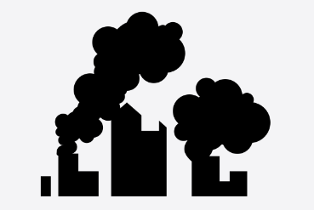
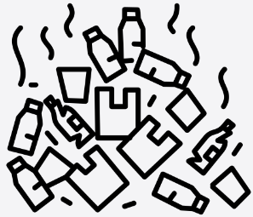
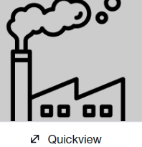
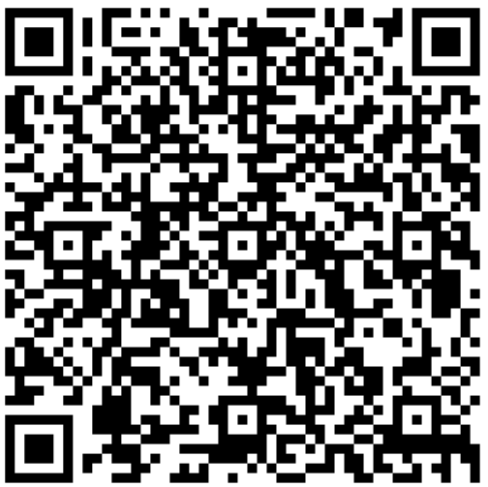
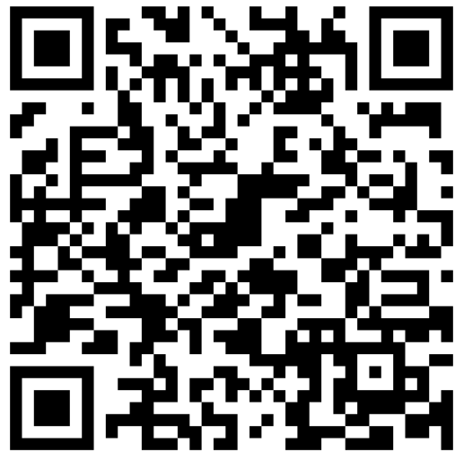
Year 5 – Pollution and Climate Change
How is pollution changing our climate?
Lesson 1 Our world is under threat from pollution. There are natural contributors to pollution – volcanoes, fires There are also human contributors to pollution – fires, plastic, transport, water/electricity use, production of materials (factories), deforestation, Our life style choices affect our levels of pollution – this is called our carbon footprint. | Lesson 2 Human choices and decisions can lead to better or worse outcomes Cities have higher levels of pollution due to having denser populations, | Lesson 3 Earth is surrounded by a layer of gases called the atmosphere Our atmosphere acts like a blanket that traps the Sun’s heat. People on Earth are making carbon dioxide, mainly through transport, manufacturing and agriculture. Extra carbon dioxide is leading to global warming as the world heats up (greenhouse effect)
Lesson 4 Actions at home can reduce our carbon footprint: Unplugging appliances Growing own fruit and veg Reducing water use – bath, switching off taps etc. Using energy efficient bulbs Recycling products rather than throwing them out | Lesson 5 Air pollution can affect human lungs -Cars are a key contributor to air pollution -Car sharing or using public transport reduce emission | Lesson 6 Renewable energy comes from natural resources that are naturally replenished, such as sunlight, wind and waves Know that non-renewable energy comes from natural resources that are not naturally replenished, such as oil and coal. Non-renewable resources, such as oil or coal, can be stored and used when they are needed.
HOW DO WE HELP PREVENT CLIMATE CHNGE?
.
How do we help prevent climate change?
Vocabulary
Ecosystem | A biological community of interacting organisms and their physical environment
Biome | Natural area of plants and animals. The world is divided into lots of biomes depending on their climate.
pollution | Pollution is the introduction of harmful materials into the environment
Atmosphere | the envelope of gases surrounding the earth or another planet.
Global Warming | Global warming occurs when carbon dioxide (CO2) and other air pollutants collect in the atmosphere and absorb sunlight and solar radiation ...
Carbon footprint | a measure of the amount of carbon dioxide released into the atmosphere as a result of the activities of a particular individual, organization, or community.
Save energy at home and in school
Walk, cycle or take public transport
Throw away less food – eat your leftovers!
Reduce, reuse, repair and recycle
Eat less meat and more vegetables
Support local causes and movements
Talk to others about the changes you make

