Slide 1
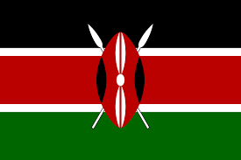
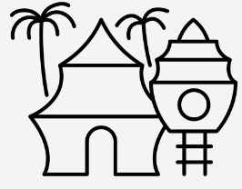
Year 4 Africa - How does Kenya compare to the UK?
Lesson 1 There are 7 continents: Asia, Africa, North America, South America, Antarctica, Europe and Oceania. There are 5 oceans: Arctic, Atlantic, Indian, Pacific, and Southern. Africa is in both the northern and southern hemisphere There are 5 regions in Africa: Northern, Eastern, Western, Southern and Central | Lesson 2 Time zones are divided by imaginary lines called meridians which run from the North Pole to the South Pole. There is an imaginary line running through the UK called the Prime Meridian. It runs through a place in London called Greenwich. The Prime Meridian splits the world into eastern and western hemispheres. Time in countries to the east of the Prime Meridian is always in front of that in the UK and west are behind. There are four time zones in Africa, one being the same as the UK | Lesson 3 Kenya is on the Eastern coast of Africa. Kenya is in the Eastern hemisphere. Physical features: Mount Kenya, Mount Nyiru, River Galana, River Turkwel, River Ewaso Ngiro, Lake Turkana. Human features: Nairobi is the capital city of Kenya. Mombasa is Kenya’s biggest coastal city. Land area: 580,370 SqKM. Population: 36.9 million
Lesson 4 Climate is the average weather condition of a place over a long period of time. Places near the equator will have a hotter climate than places near the North and South Poles which will have a colder climate. In Kenya there are no summers or winters there, instead the climate is hot throughout the year. Rainy season - usually fall from April to May Parts of the country are dry and receive very little rain even in the rainy season Most of the country is covered by thorny bushes, which make the environment very hard to live in. | Lesson 5 The Maasai are a tribe of people who live in parts of Tanzania and Kenya and are known as tall and fierce warriors. They can be recognised by the special red cloth they wear. Maasai people live a nomadic life, which means they move from place to place with their animals. They rely on their animals for food They get all the other foods they need by trading (swapping) with other Maasai people. Maasai men herd cattle and carry spears to protect their cattle from wild animals such as lions. The Maasai women are responsible for cooking, collecting sticks for the fire and building the home | Lesson 6 Their grazing ranges have been reduced, so they have had to resort to other ways of earning money such as performing for tourists or selling souvenirs to tourists. Abandoning their nomadic ways. The Maasai entertain the tourists by doing traditional dance performances for them and selling souvenirs. In the past the Maasai would not perform just to entertain and would only trade with other Maasai for the things they needed.
HOW DO WE HELP PREVENT CLIMATE CHNGE?
.
Equator | a line notionally drawn on the earth equidistant from the poles, dividing the earth into northern and southern southern hemispheres
Hemisphere | a half of the earth, usually as divided into northern and southern halves by the equator
Continent | any of the world's main continuous expanses of land
Indigenous | being a people who are the original, earliest known inhabitants of a region
Nomadic | someone who lives by traveling from place to place.
Human Features | Human features are things made or built by humans like cities, houses, roads, bridges, ports, farms, factories,
Physical Features | Physical Features are the natural features on the Earth's surface​.
Culture | the ideas, customs, and social behaviour of a particular people or society
To find out more
Vocabulary

