Slide 1
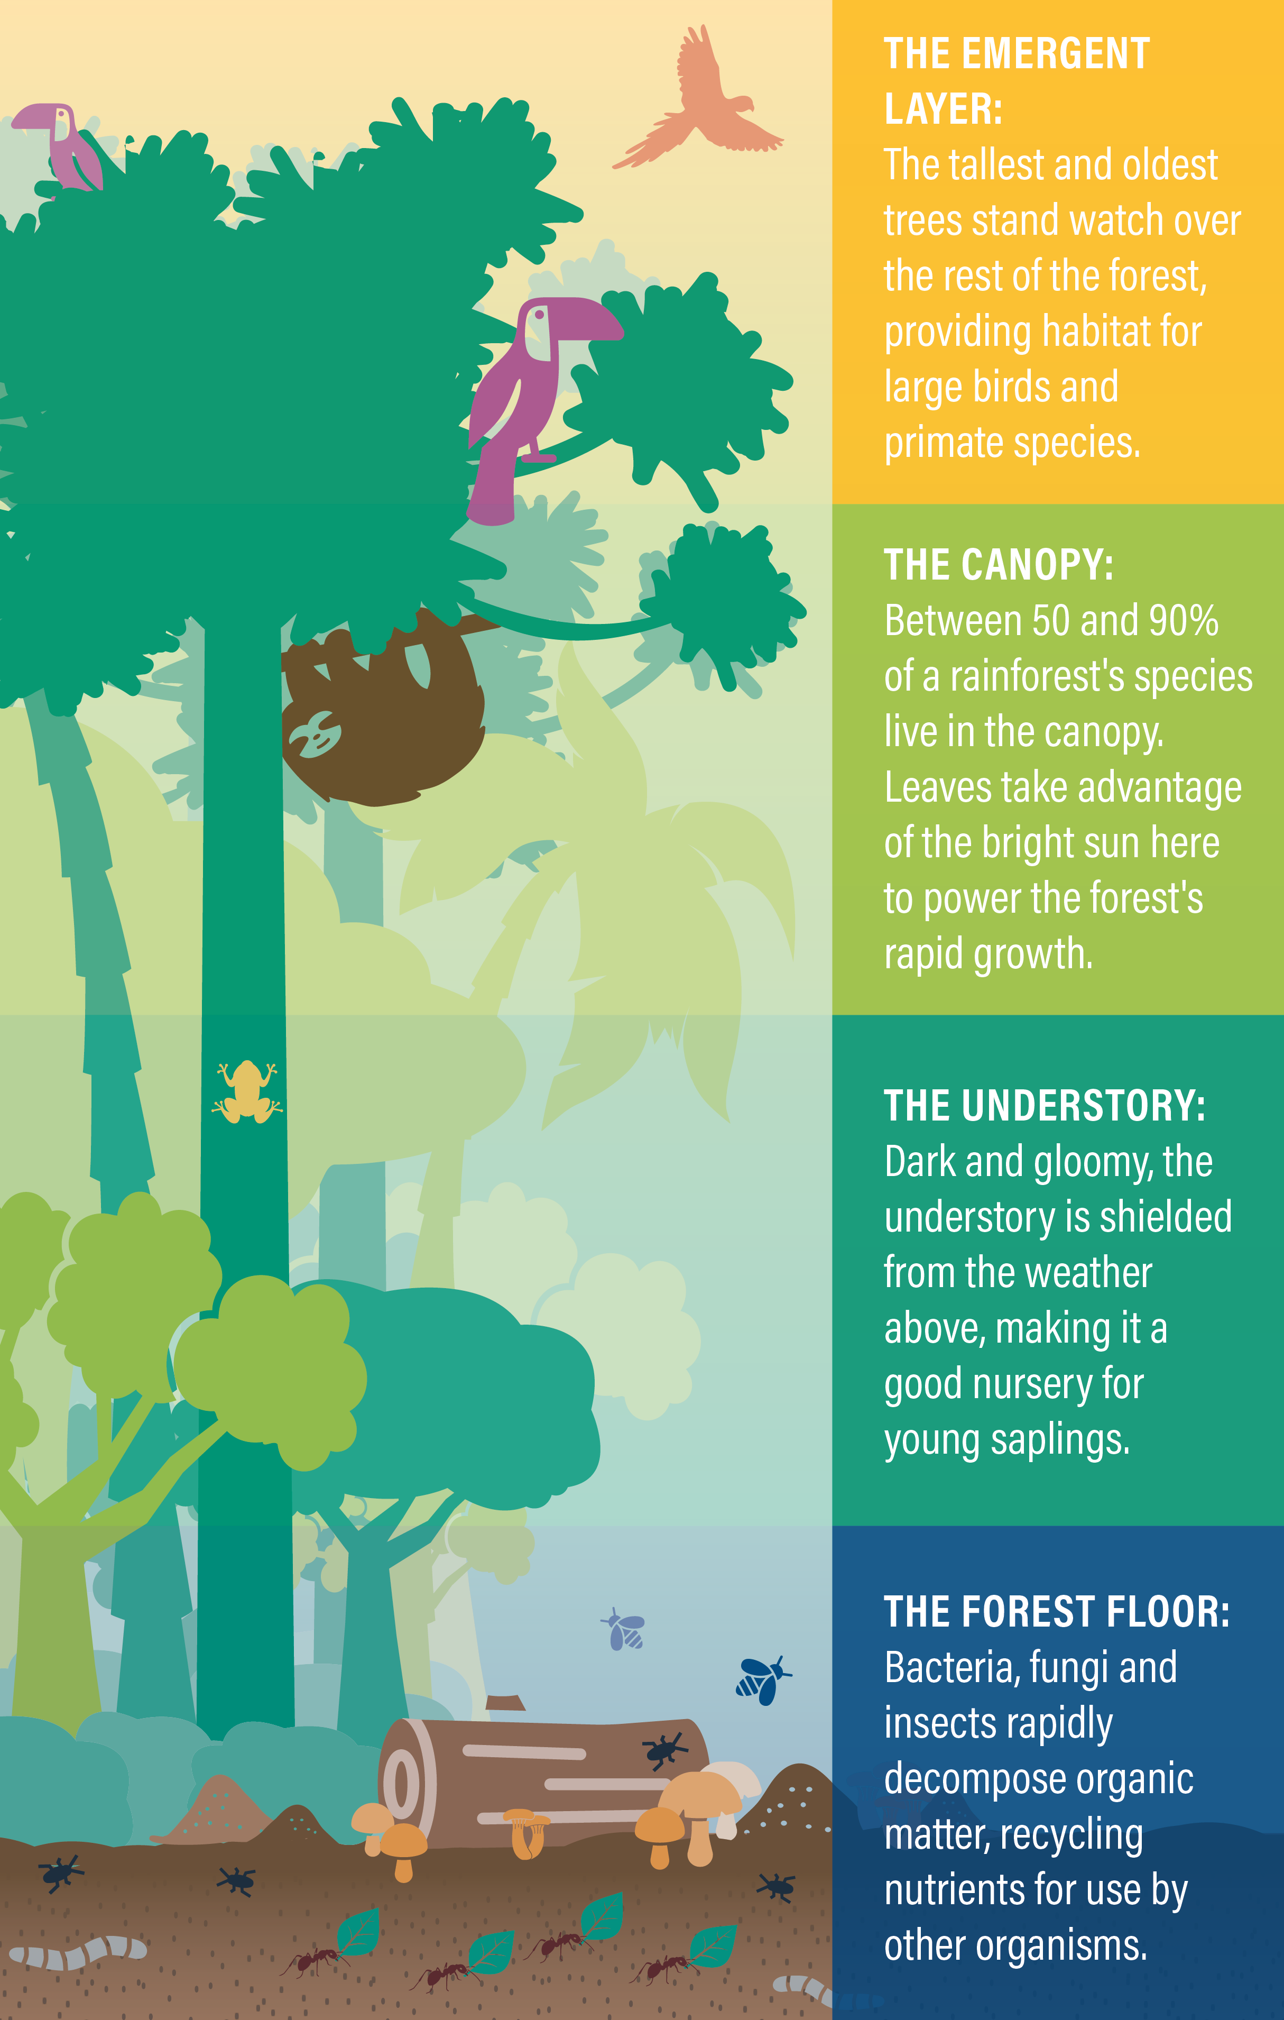
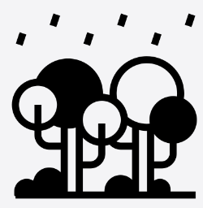
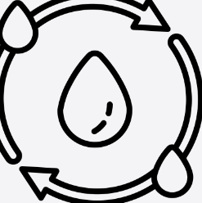
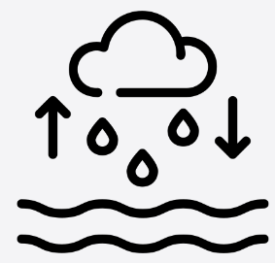
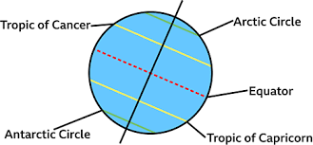
Year 5 - Rainforests
How does the climate of the Amazon Rainforest impacts its biodiversity?
Lesson 1 Biomes Tundra - coldest Deciduous forest Rainforest –most biodiverse Grassland Desert – driest Marine - largest | Lesson 2 Lines of latitude run horizontally around the Earth. The Equator is the central line which splits the Earth into Northern and Southern hemispheres. The Tropic of Cancer to the north and the Tropic of Capricorn to the south –the Amazon rainforest is located in and around the Tropic of Capricorn. Lines of longitude run from pole to pole and are used to give use time zones. Both lines tell positions. Latitude shows the north/south position and that longitude shows the east/west position of a location. | Lesson 3
Lesson 4 The Amazon has huge biodiversity (lots of different plants and animals) The hot and humid climate supports this because the ground is rich in nutrients and human population is sparse. Coffee, bananas and nuts originate there. The land is use for farming, conservation and logging. | Lesson 5 Water evaporates from the ground and plants and trees release water through transpiration. Droplets condenses in clouds and falls to earth as rain, snow or hail in a process called precipitation Water flows across the land in rivers and streams in a process called surface run-off and under the ground as groundwater. | Lesson 6 The Tropic of Cancer to the north of the equator and The Tropic of Capricorn to the south of the equator The Amazon rainforest is located in and around the Tropic of Capricorn
HOW DO WE HELP PREVENT CLIMATE CHNGE?
.
canopy | is a layer of something that spreads out and covers an area, for example the branches and leaves that spread out at the top of trees in a forest.
Forest floor | The upper layer of mixed soil and decayed or decaying organic material typical of forested land.
Shrubbery | a group of shrubs or an area where shrubs are growing
Transpiration | the process by which water is pulled from the roots of the plant through the stems and leaves and released through microscopic holes in the leaves called stomata
Condenses | a process by which a substance changes from a gaseous state to a liquid state.
Surface run off | Water that reaches land directly may flow across the ground and collect in the oceans, rivers or lakes
To find out more …
Vocabulary

