Slide 1
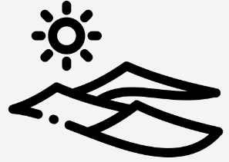

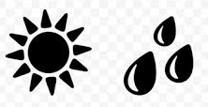
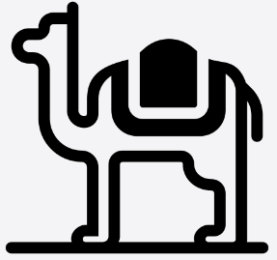
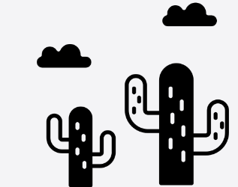



Year 3 - Deserts
Are deserts always hot and deserted?
What are we learning?
Lesson 1 7 continents from largest to smallest - Asia, Africa, North America, South America, Antarctica, Europe, and Australia The UK is a temperate country so doesn’t usually experience extremely cold winters or summers. climate, latitude, longitude | Lesson 2 A desert ecosystem has the following characteristics: Arid environment. Extreme temperatures. High wind velocity. Sparsity of cloud cover. Absence of water vapour in air. desert, climate, precipitation, average | Lesson 3 The Atacama desert is in Chile in South America It is the driest non polar desert in the world Nasa use it to test their space crafts as the environment is the closet on Earth to that of Mars. rainfall, average, bar chart, South America, fieldwork
Lesson 4 Earth can be divided into polar, temperate, sub-tropical and tropical zones and each tend to have different climates and biomes. Animals and plants adapt to their environments. Desert animals - Long eyelashes, thick eyebrows, and hairy ears help keep sand and sun out of animals' eyes and ears. Nocturnal (when come out when it is cooler) Live in burrows and can retain water. | Lesson 5 Small leaves on desert plants help reduce moisture loss during photosynthesis. Desert trees, such as the acacia tree, have short wide trunks so they can store water in them vegetation regions, forest, grassland, tundra, desert, and ice sheet, climate | Lesson 6 Snakes Lizards Rats Scorpions Insects Spiders camels
.
To find out more …
Desert, | Deserts are areas in which there is a shortage of moisture available for plants.
Climate, | The weather found in a certain place over a long period of time is known as the climate
Precipitation | The liquid and solid water particles that fall from clouds and reach the ground
Environment | All the physical surroundings on Earth are called the environment
Temperate | Mild temperatures and moderate rainfall.
Biome | Areas of the planet with a similar climate and landscape, where similar animals and plants live
Vegetation | The plant life of a region or the plant community
Region | An area that is defined by certain similar characteristics
Habitiat | The place where an organism lives is known as a habitat.
Vocabulary

