Slide 1



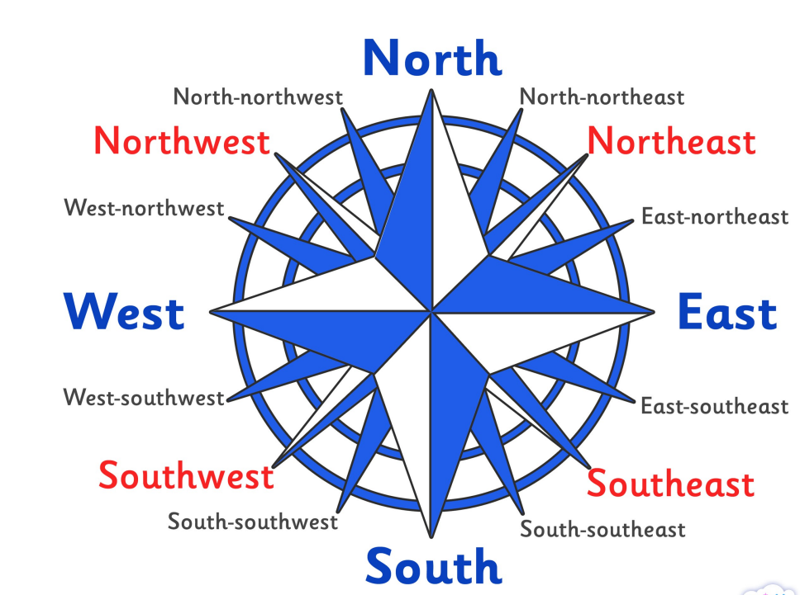





Year 6 – Cities of Industry
What characteristics UK cities have and how they change over time.
What are we learning?
1 Can you find, London, Liverpool, York, Norwich, Cardiff, Newcastle, Aberdeen, Belfast, Londonderry and Glasgow on a map? London in South East of Liverpool. | 2 Human features of cities - houses, roads and bridges. Cathedral and university. *Lots of buildings for housing and businesses/organisations. *Transportation networks. *Large populations. *A central hub/inner city area and a suburban area. Population means the number of people living in a certain area. | 3 London has changed over time. Greater population. Better transportation – trains (tube and underground) and subways help pedestrians keep safe. More hospitals. More immigrants and business opportunities. Less town houses more
4 Trade – to buy and sell goods and services. In the Stone Age, goods were traded but only locally. Now, globalisation means countries have become more connected. Goods can be packaged. People can communicate via technology. Factories can produce large amounts to be transported around the world. | 5 The three-sector model of trade: Primary - extraction of raw materials Secondary - manufacturing Tertiary - transport, distribution and sale of goods | 6 The most common products traded by Britain are cars, generators and medicines. The UK’s top trading partners are US, Germany, Ireland and Netherlands. That products are imported/exported by countries based on their human and physical features.
HOW DO WE HELP PREVENT CLIMATE CHNGE?
.
To find out more
Vocabulary
Field Work
local | neighbourhood
regional | Area, district around you
global | Relationships around the global where trade my occur
city | A large town
urban | Built up area
rural | countryside
trade | Exchange of goods or services
Supply chain | Production and distribution of something
Trade partners | a person, organization, or country with whom somebody customarily does business.
Walk to River Park and compare the Liverpool skyline to Snowdonia discussing the physical and human changes differences.

