Slide 1
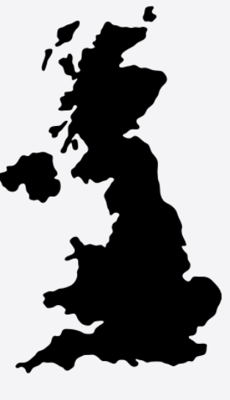
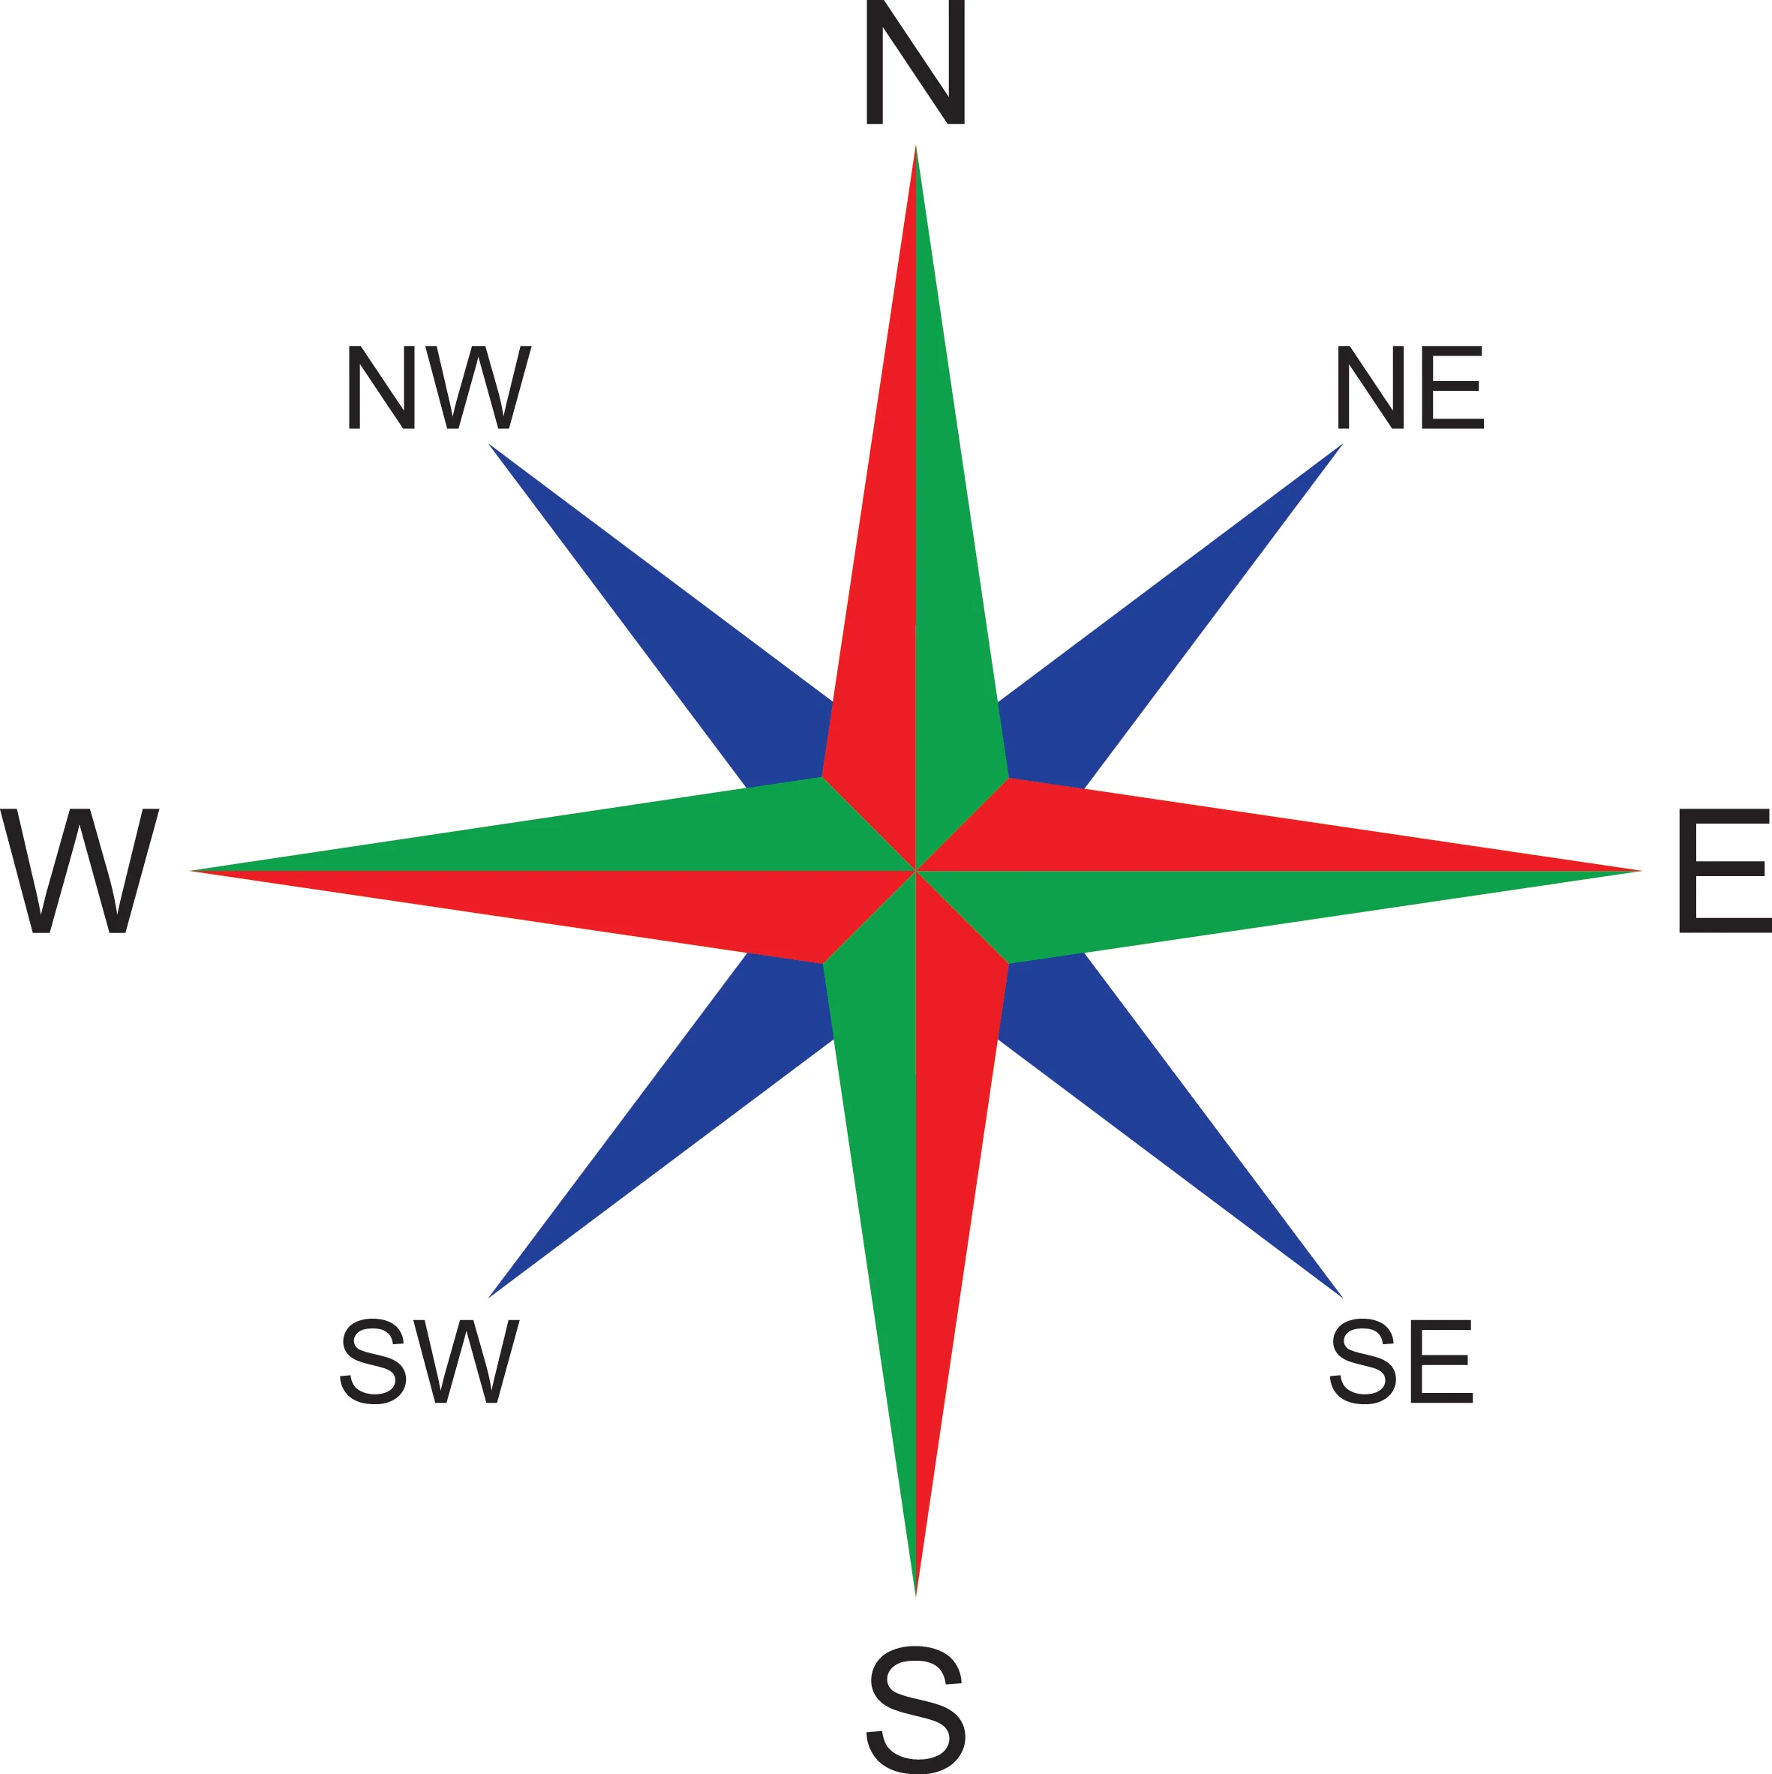
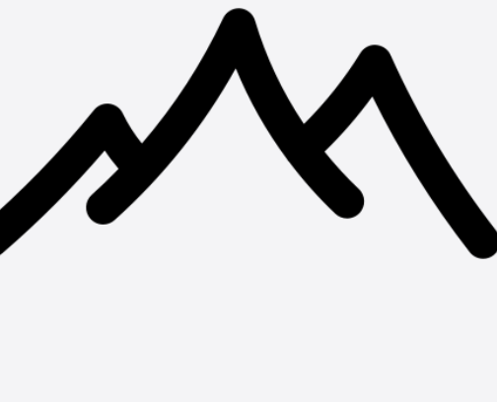
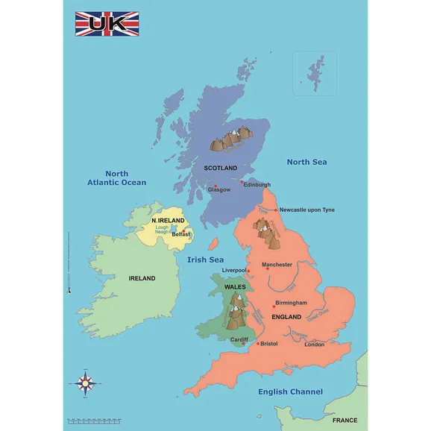
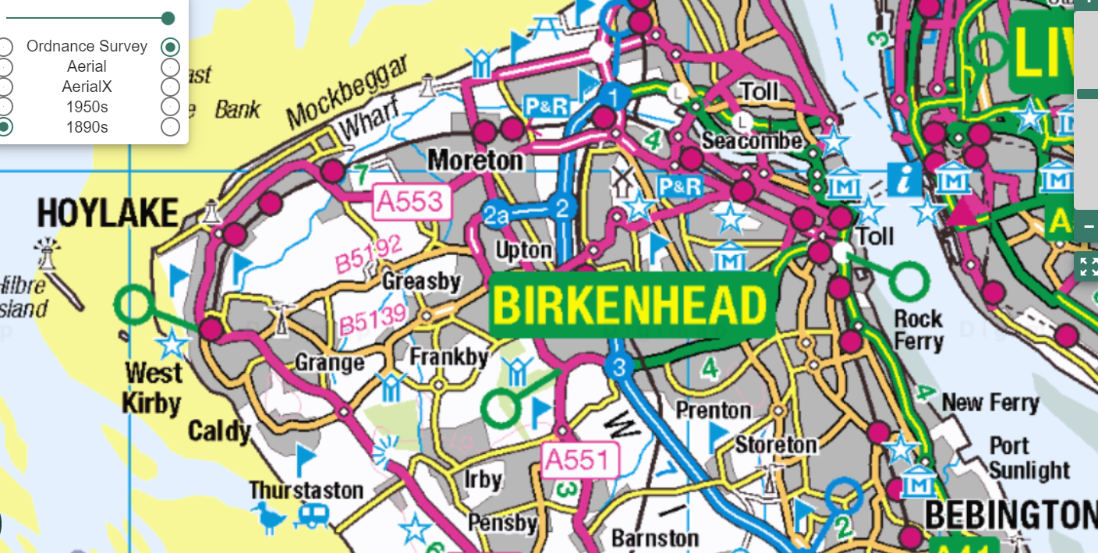
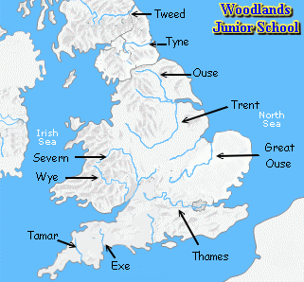
Year 3 - Geographical regions of the UK
What are the features of the UK ?
What are we learning ?
Lesson 1 Great Britain The collective name of England, Scotland and Wales. It does not include Northern Ireland The United Kingdom The United Kingdom of Great Britain and Northern Ireland (to give its full name) refers to the political union between England, Wales, Scotland and Northern Ireland. The British Isles This refers to the islands of Great Britain and Ireland – including the Republic of Ireland – and the 5000 or so smaller islands scattered around our coasts, such as the Channel Isles. | Lesson 2 A city is a place where many people live closely together. It may have a cathedral. Some Cities of the Uk :- London, Birmingham, Manchester, Liverpool, Bristol, Leeds, Edinburgh, Cardiff, Belfast. London is South East of Liverpool. Edinburgh is North East of Liverpool. Bristol is south west of Birmingham | Lesson 3 A mountain is a landform that rises high above the surrounding terrain in a limited area. They are made from rocks and earth. Generally, mountains are higher than 600 meters. The main mountains in the UK (Ben Nevis – Scotland, Snowdon - Wales, Scarfell Pike - England, Mourne Mountains – NI A mountainous area on a map is coloured in brown.
Lesson 4 Location of the seas around the UK. North Sea, The English Channel, Irish Sea Atlantic Ocean | Lesson 5 The Wirral is situated in the North West of England and is a peninsula. This means it is surrounded by water on three sides. Places change over time. Older maps show | Lesson 6 A river is a large natural stream of water that flows over land. Some rivers in the Uk are :River Mersey, River Dee, River Thames, River Ouse, River Wye, River Tay and River Spey.
HOW DO WE HELP PREVENT CLIMATE CHNGE?
.
Vocabulary
Vocabulary
Location | A location is the place where a particular point or object exists.
Compass | North, south, east, and west are known as the cardinal directions. These are the main points on a compass.
Mountain range | Mountains are areas of land that are much higher than the land surrounding them.
erosion | Water, wind, and other natural forces cause rocks and earth to wear away.
source | The place where something begins, where it springs into being.
meander | a turn or winding of a stream.

