Slide 1
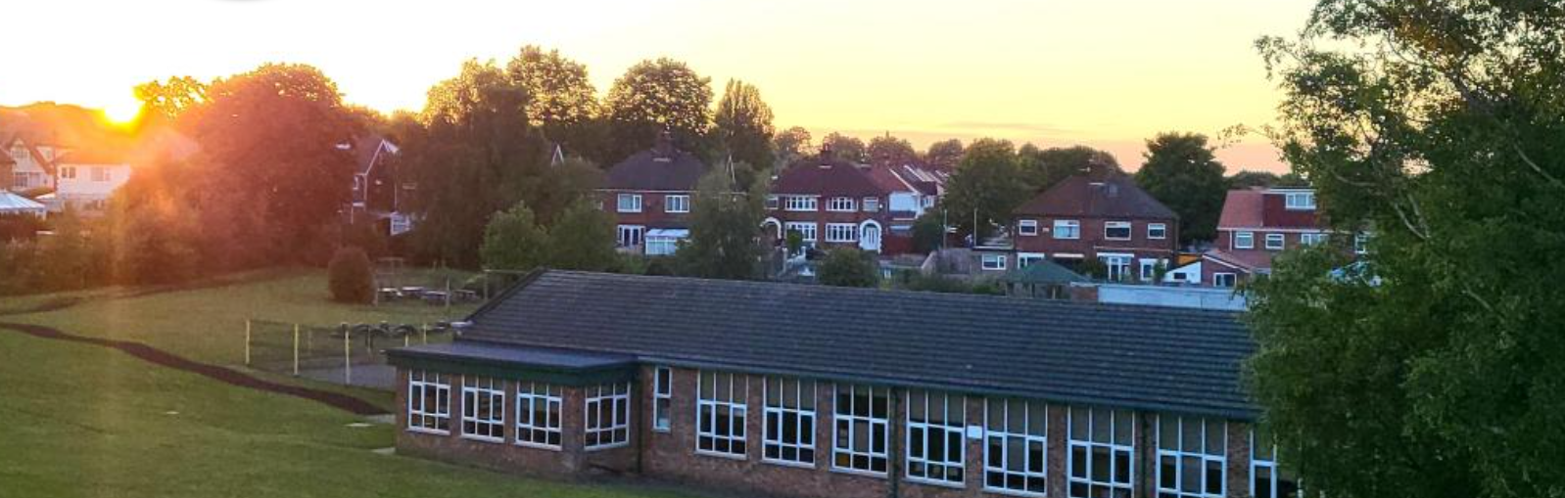


Brackenwood Junior School
Year 3 2024-2025

Slide 2
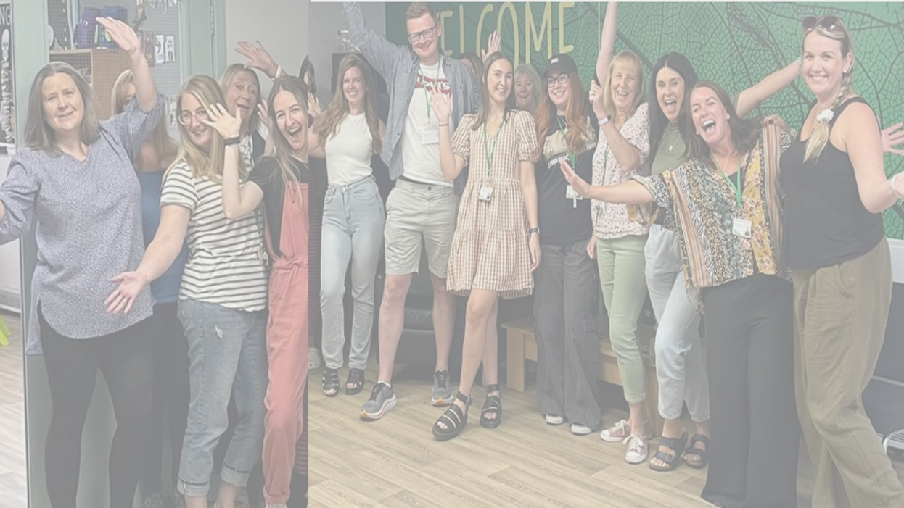

Miss Fry – Headteacher
Mrs Lees - Assistant Head - Year 5 and 6 Lead
Ms Balmer – Assistant Headteacher - Year 3 and 4 Lead and SENCO
Mrs Nicol – School Business Manager
8 Teachers and 8 teaching assistants.
Oak Trees MAT
Mr Lacey – Chief Executive Officer
Mrs Finnegan - Deputy Chief Executive Officer
Mrs Arnold – School Improvement Lead

Slide 3


At Brackenwood Juniors, we aim to prepare our children as life-long learners and to become successful, resilient members of society.

Slide 4
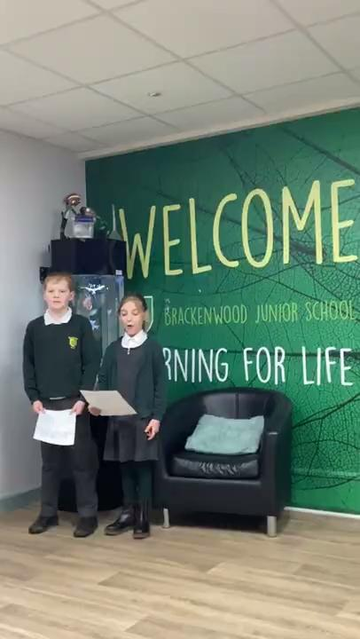

Slide 5
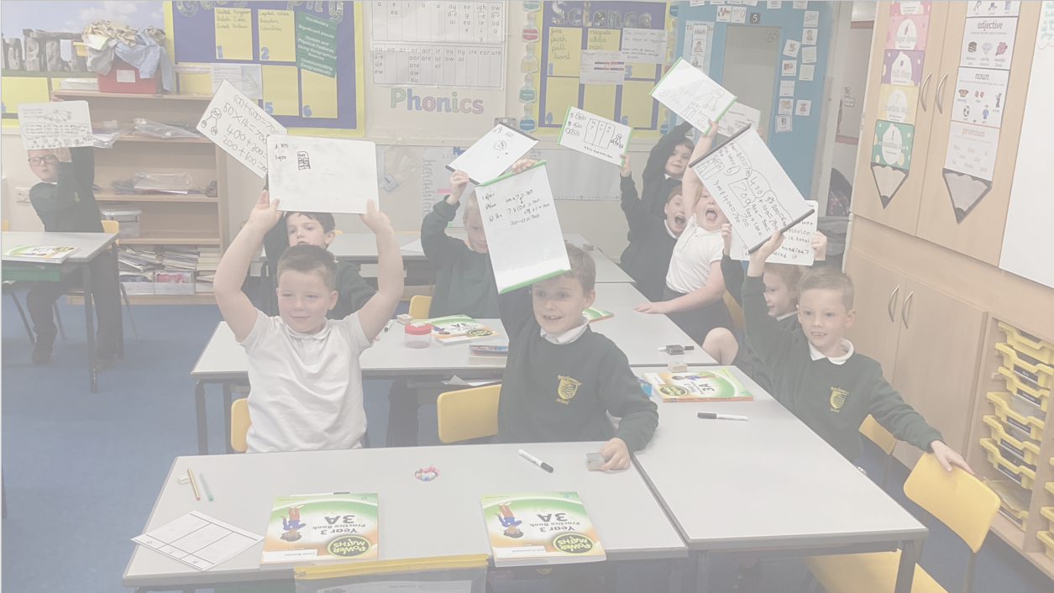
About our school
We are an inclusive 2-form entry school with 230+ children on roll - catering for children aged 7-11.
Our committed and hardworking team have high expectations of all children both academically and socially and we recognise the importance of fostering a supportive and nurturing environment.
We are one of 11 schools that form Oak Trees Multi-Academy Trust and it is still growing which is really positive. As a Trust we work collaboratively to ensure enriching learning experiences for our children. We are part of the biggest trust on the Wirral, which provides us with many opportunities and it is fantastic to work so closely with many other Wirral-based schools.

Slide 6

Curriculum Enrichment opportunities
2 residential visits – Year 4, Year 6
Ambassador roles across school
Annual visit to the Pantomime at Christmas
Links with Hilbre High School (Part of Oak Trees Multi-academy Trust) as well as other local schools
Community Work - Nursing Home, Food bank, Street Safe, Church
Swimming lessons –Y4
Trips linked to the Curriculum – Styal Mill, Chester Zoo, Philharmonic, Roman Museum in Chester, links with Wirral Boys and Girls School amongst others
Visitors/workshops linked to the curriculum - Tom Sherrington - Retrieval
Oak Trees MAT events – charity events, sporting events, Y4 Levers Project, EurOAKvision, KaraOAKtree.
Opportunities for parents to support in school - DT, Reading Roadshow, STEM Week, Reading volunteers, trips and visits, Brackenwood Fundraising Group (PTA)

Slide 7
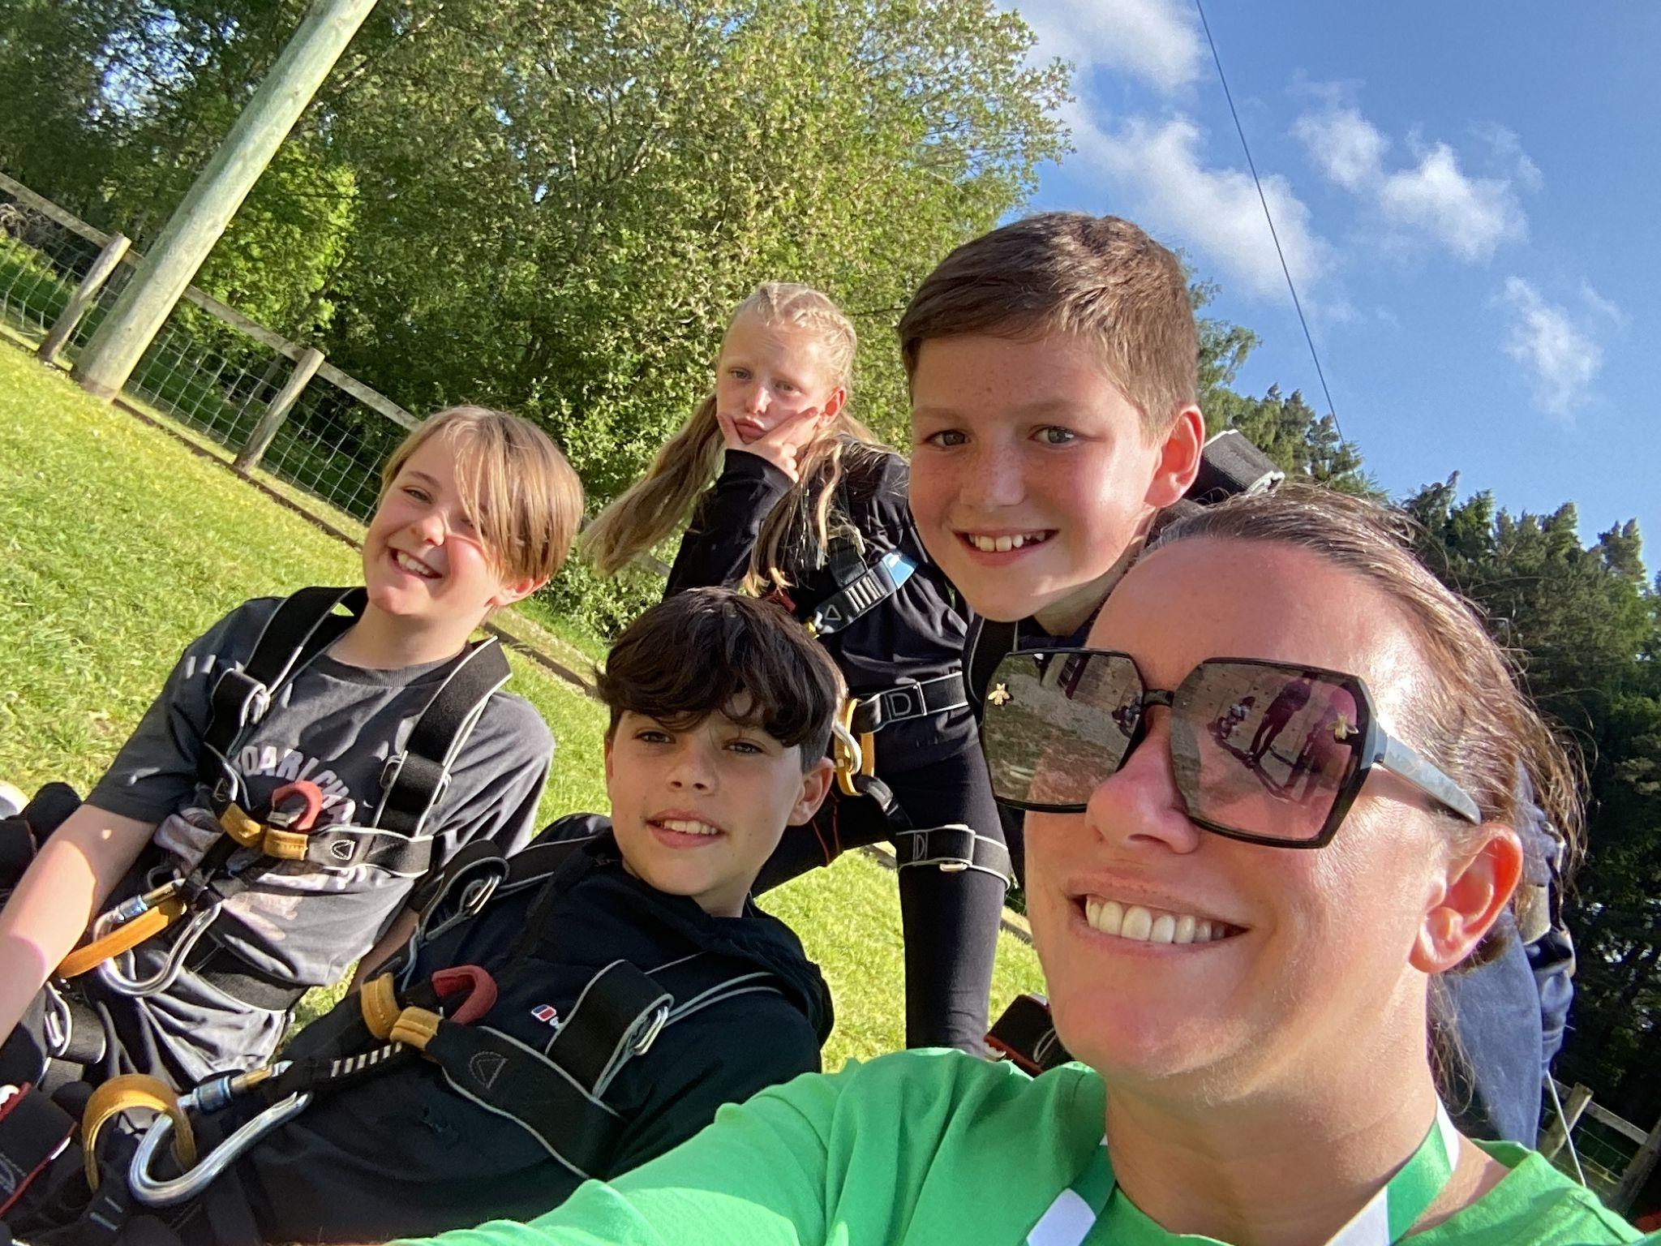
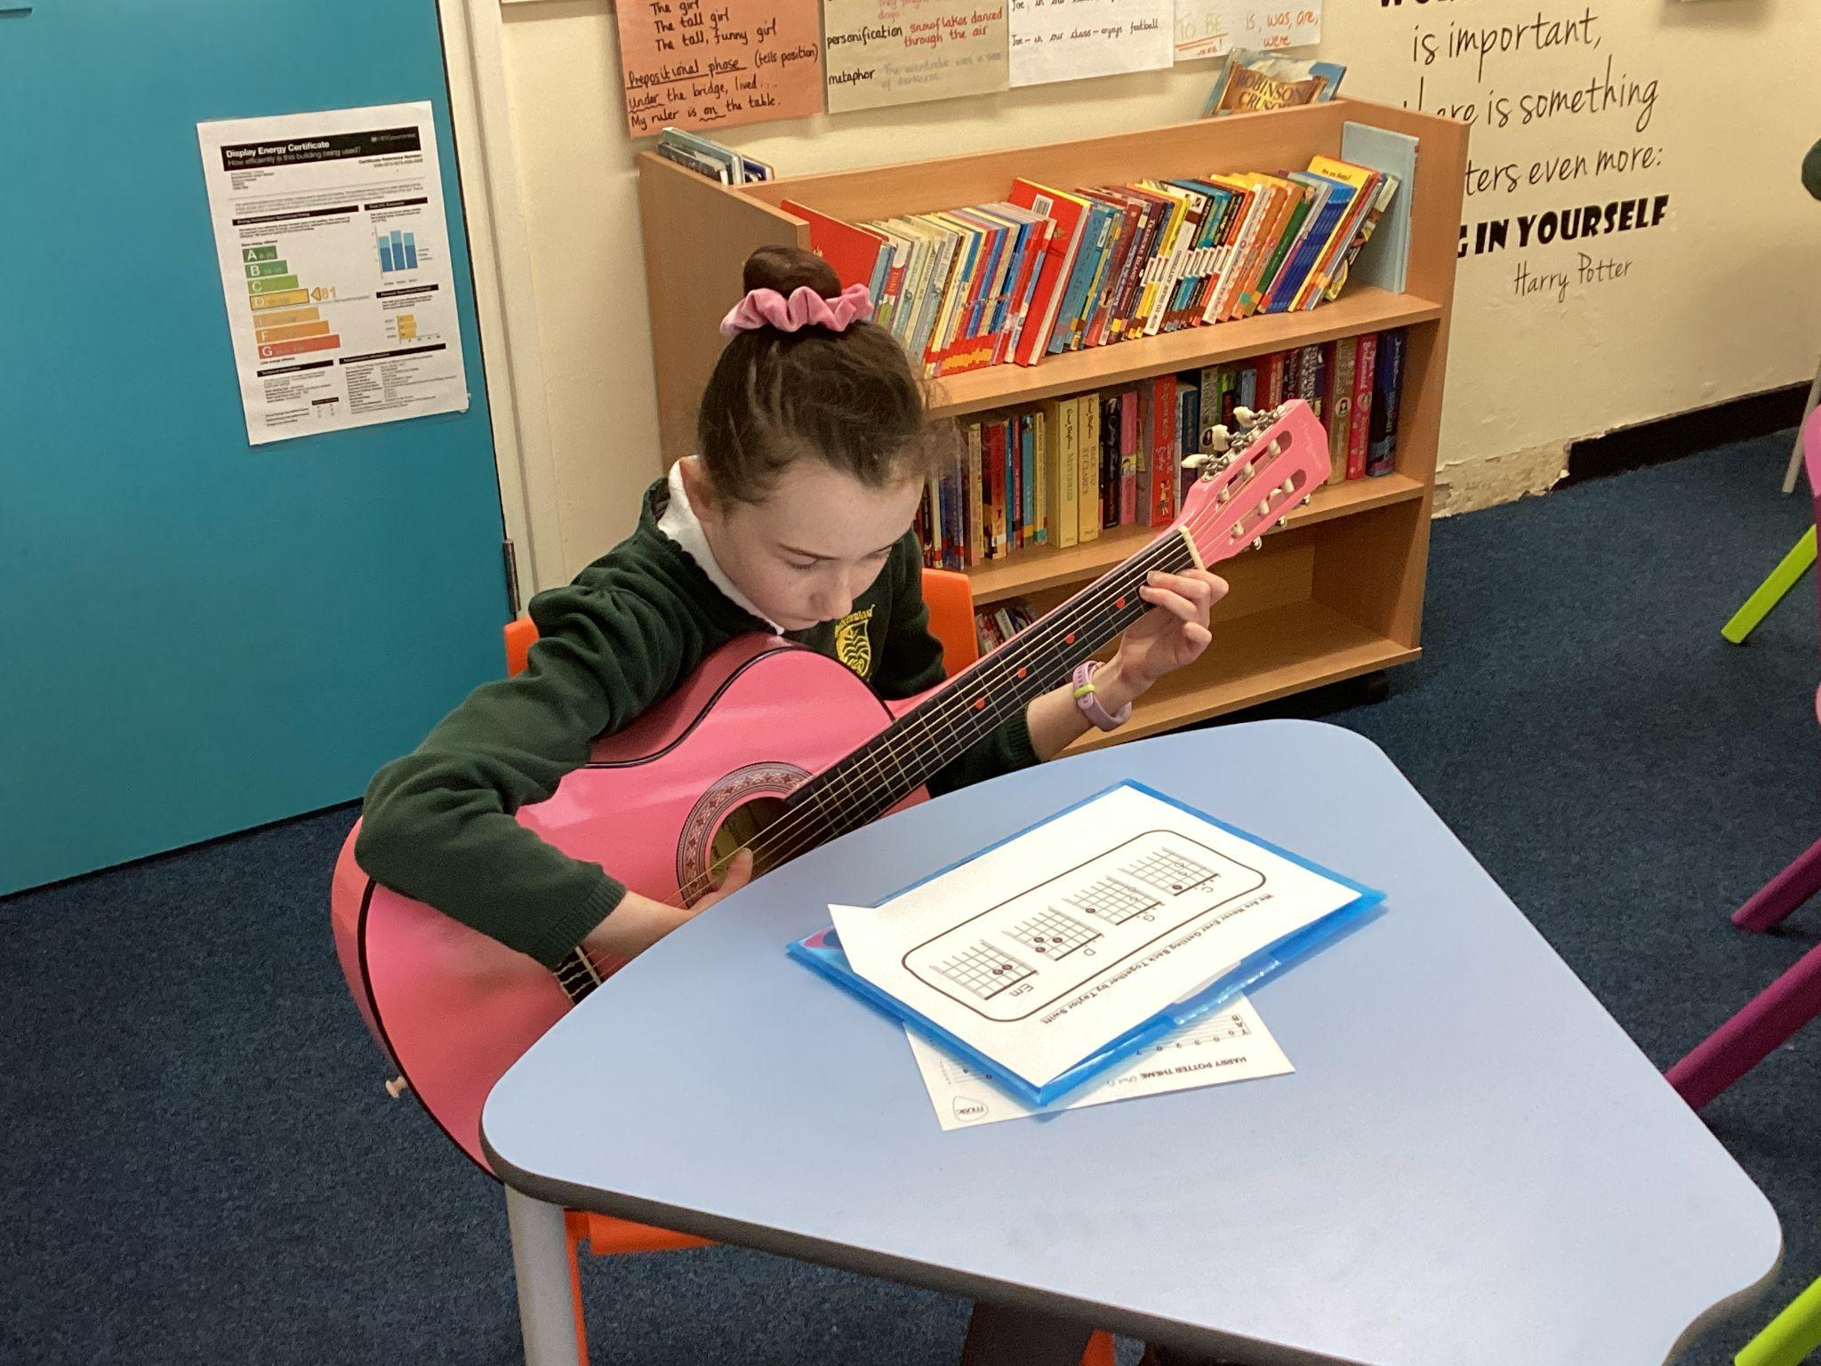
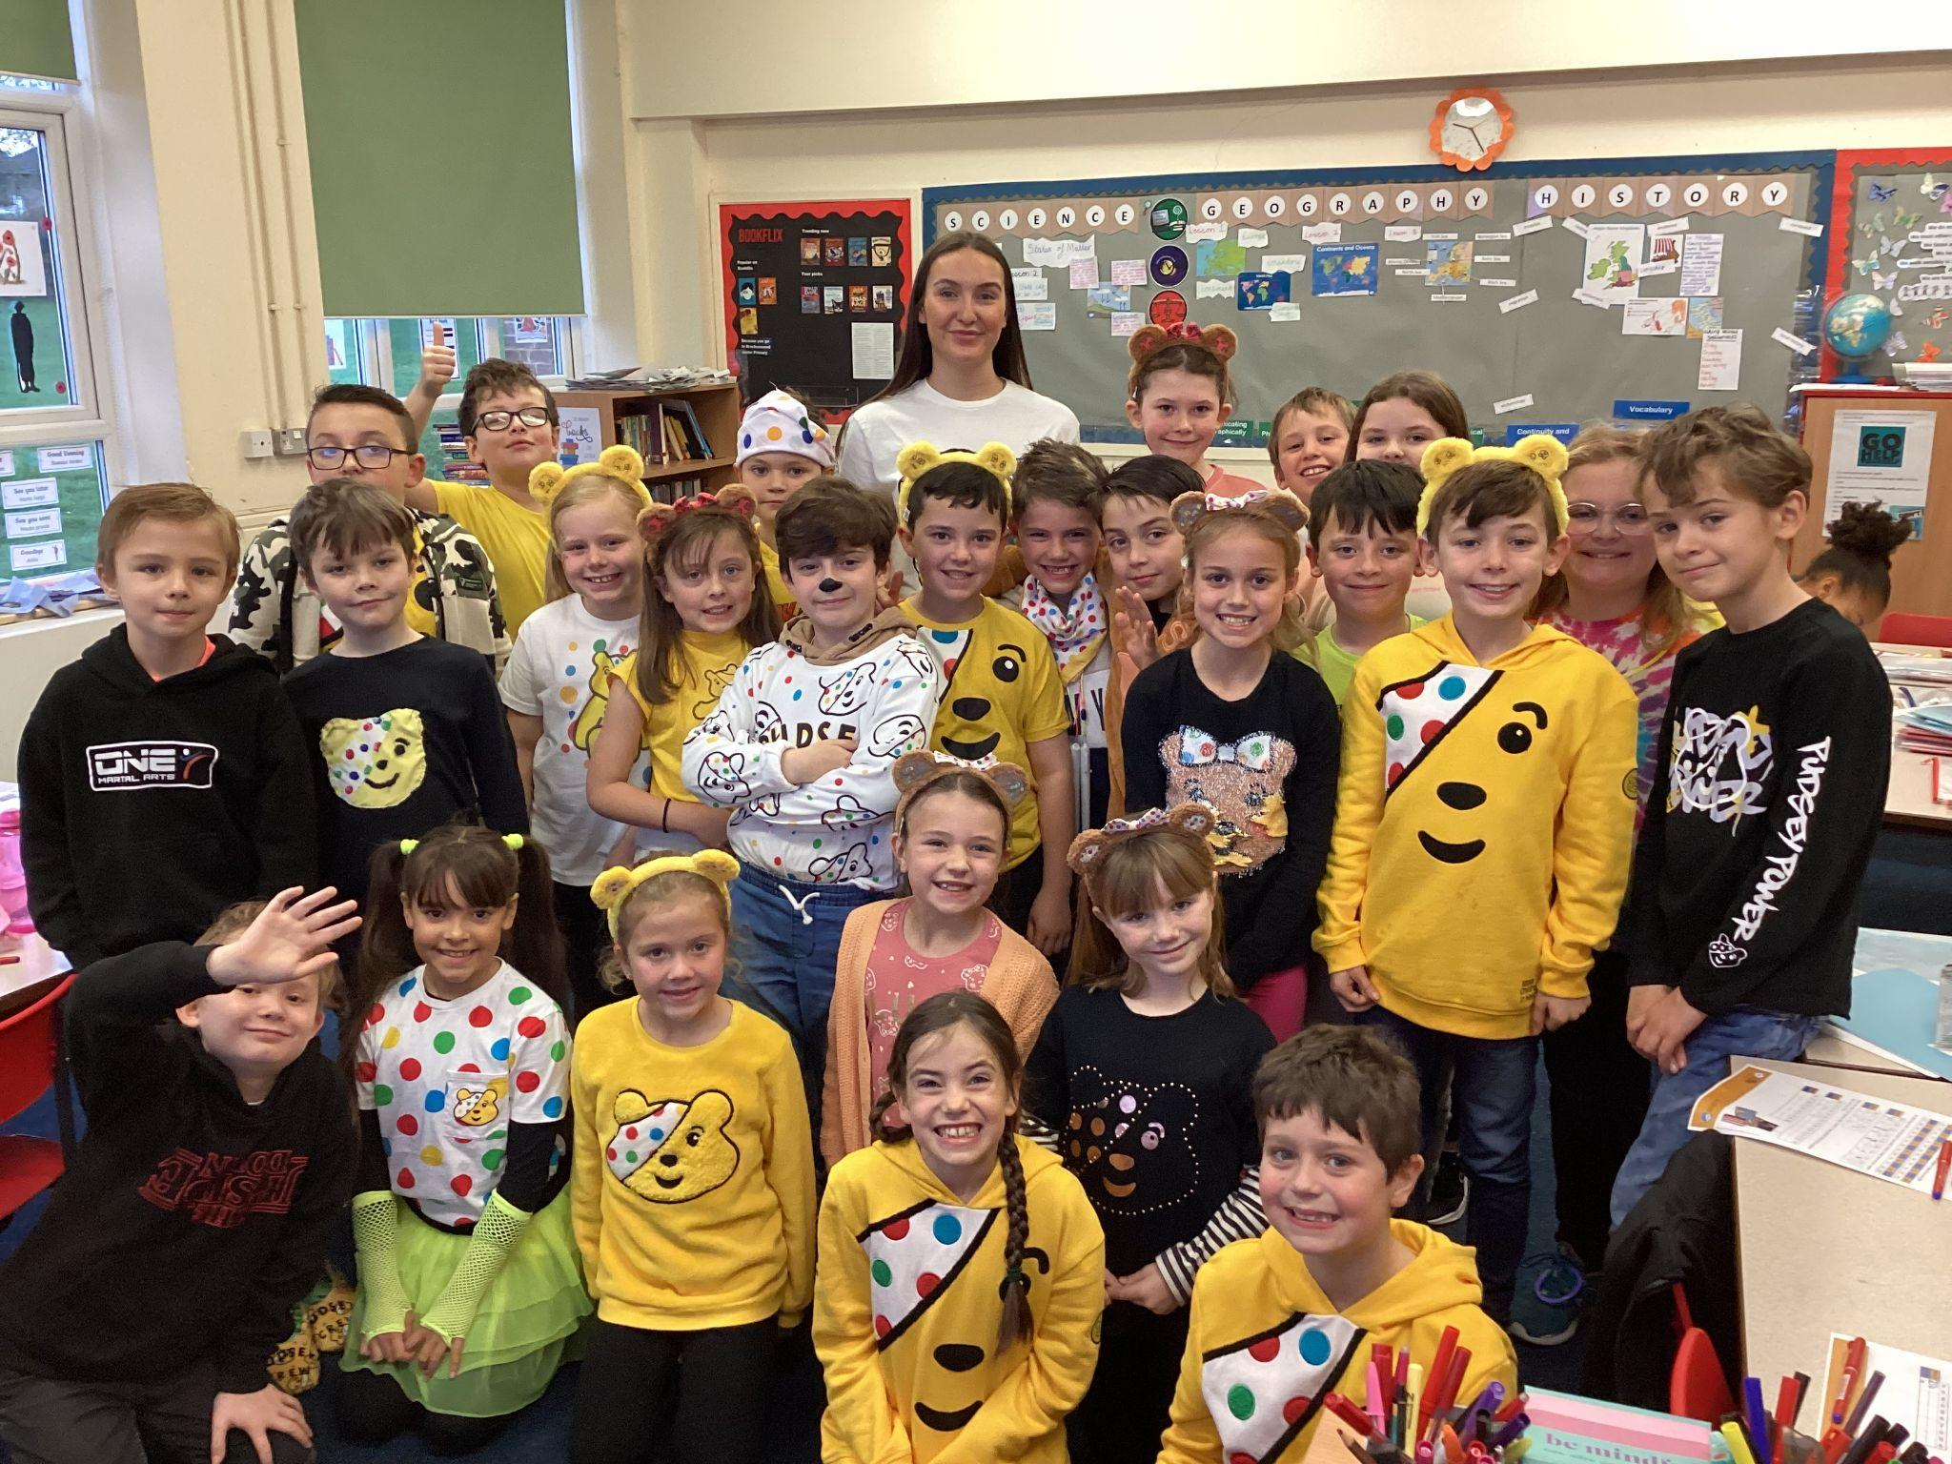
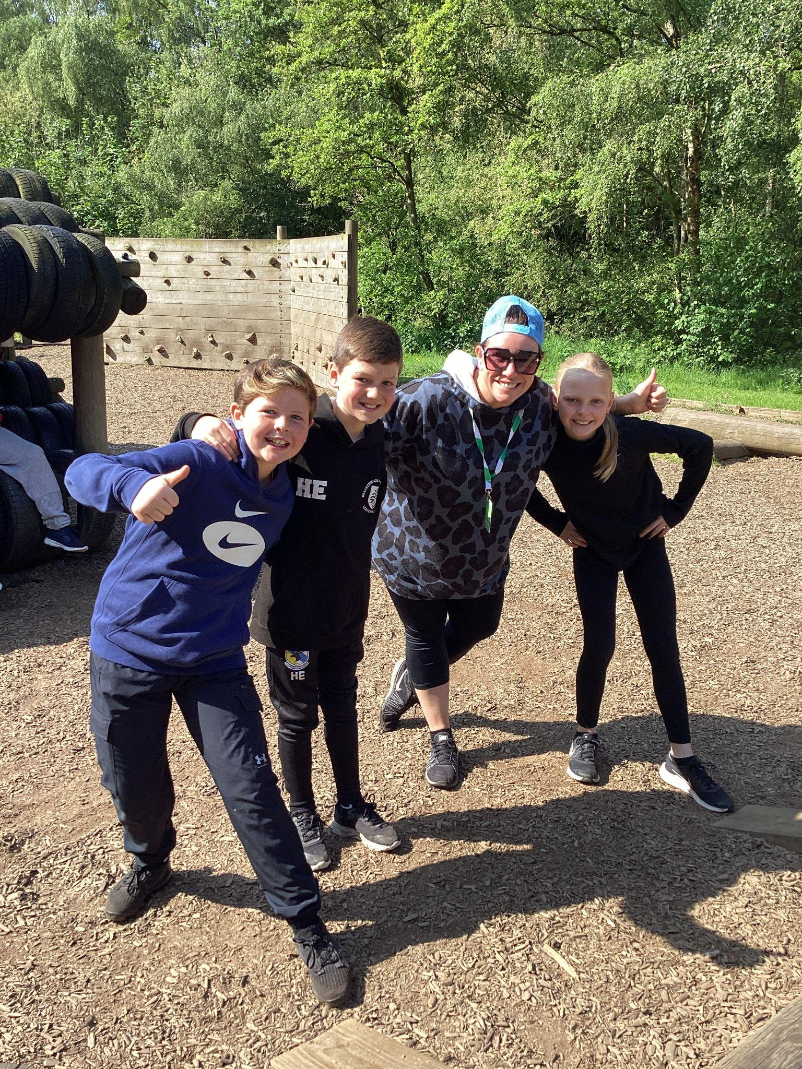
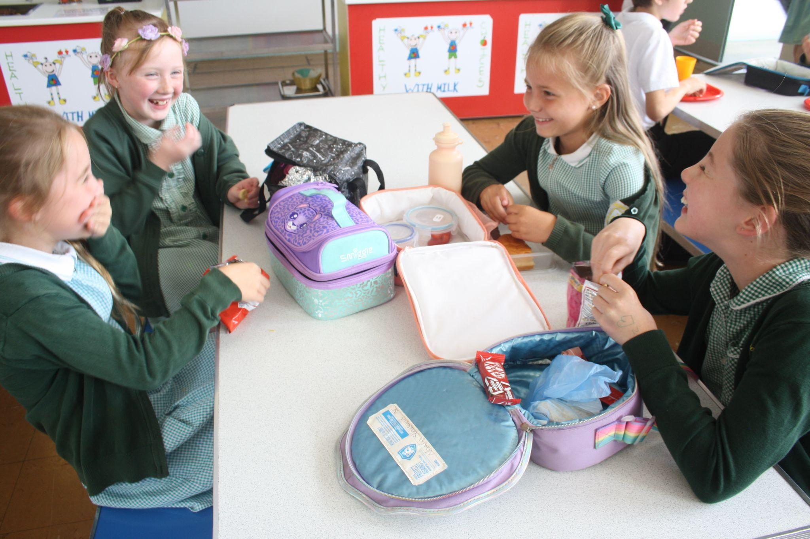
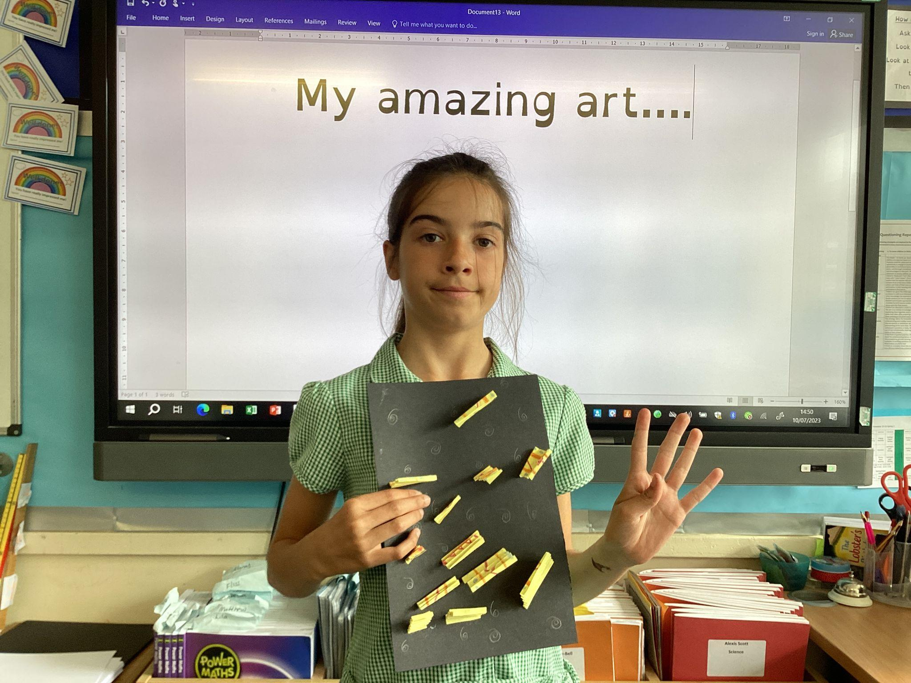
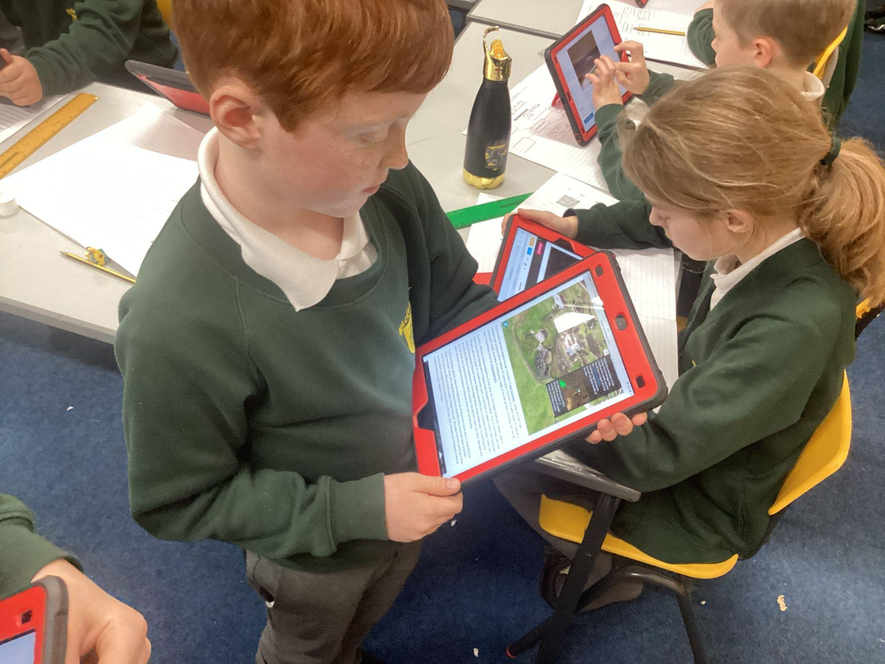
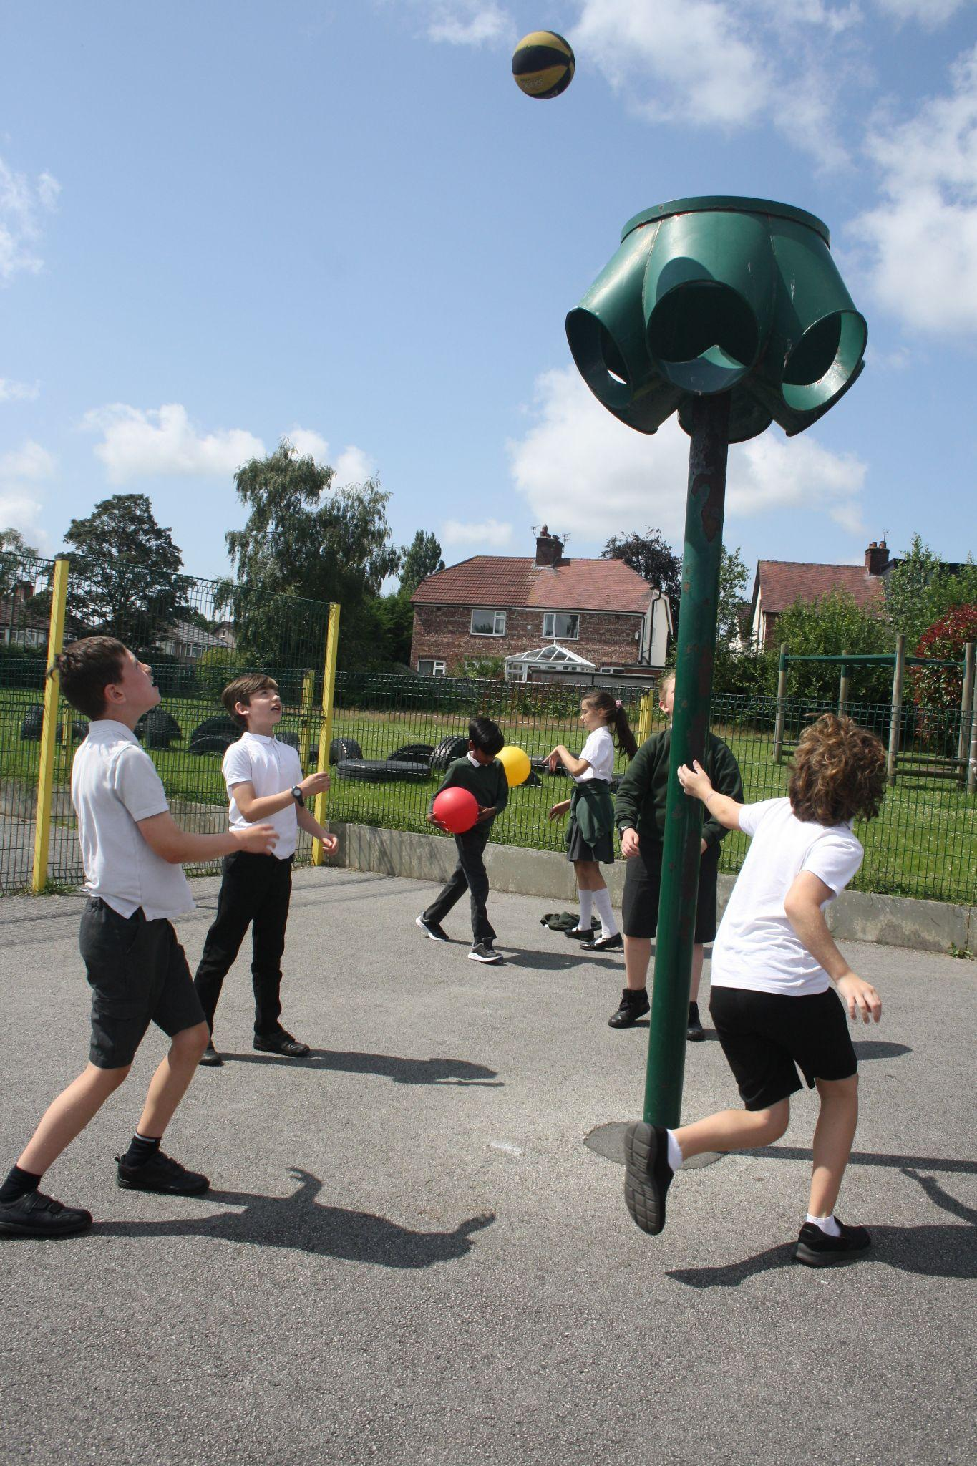
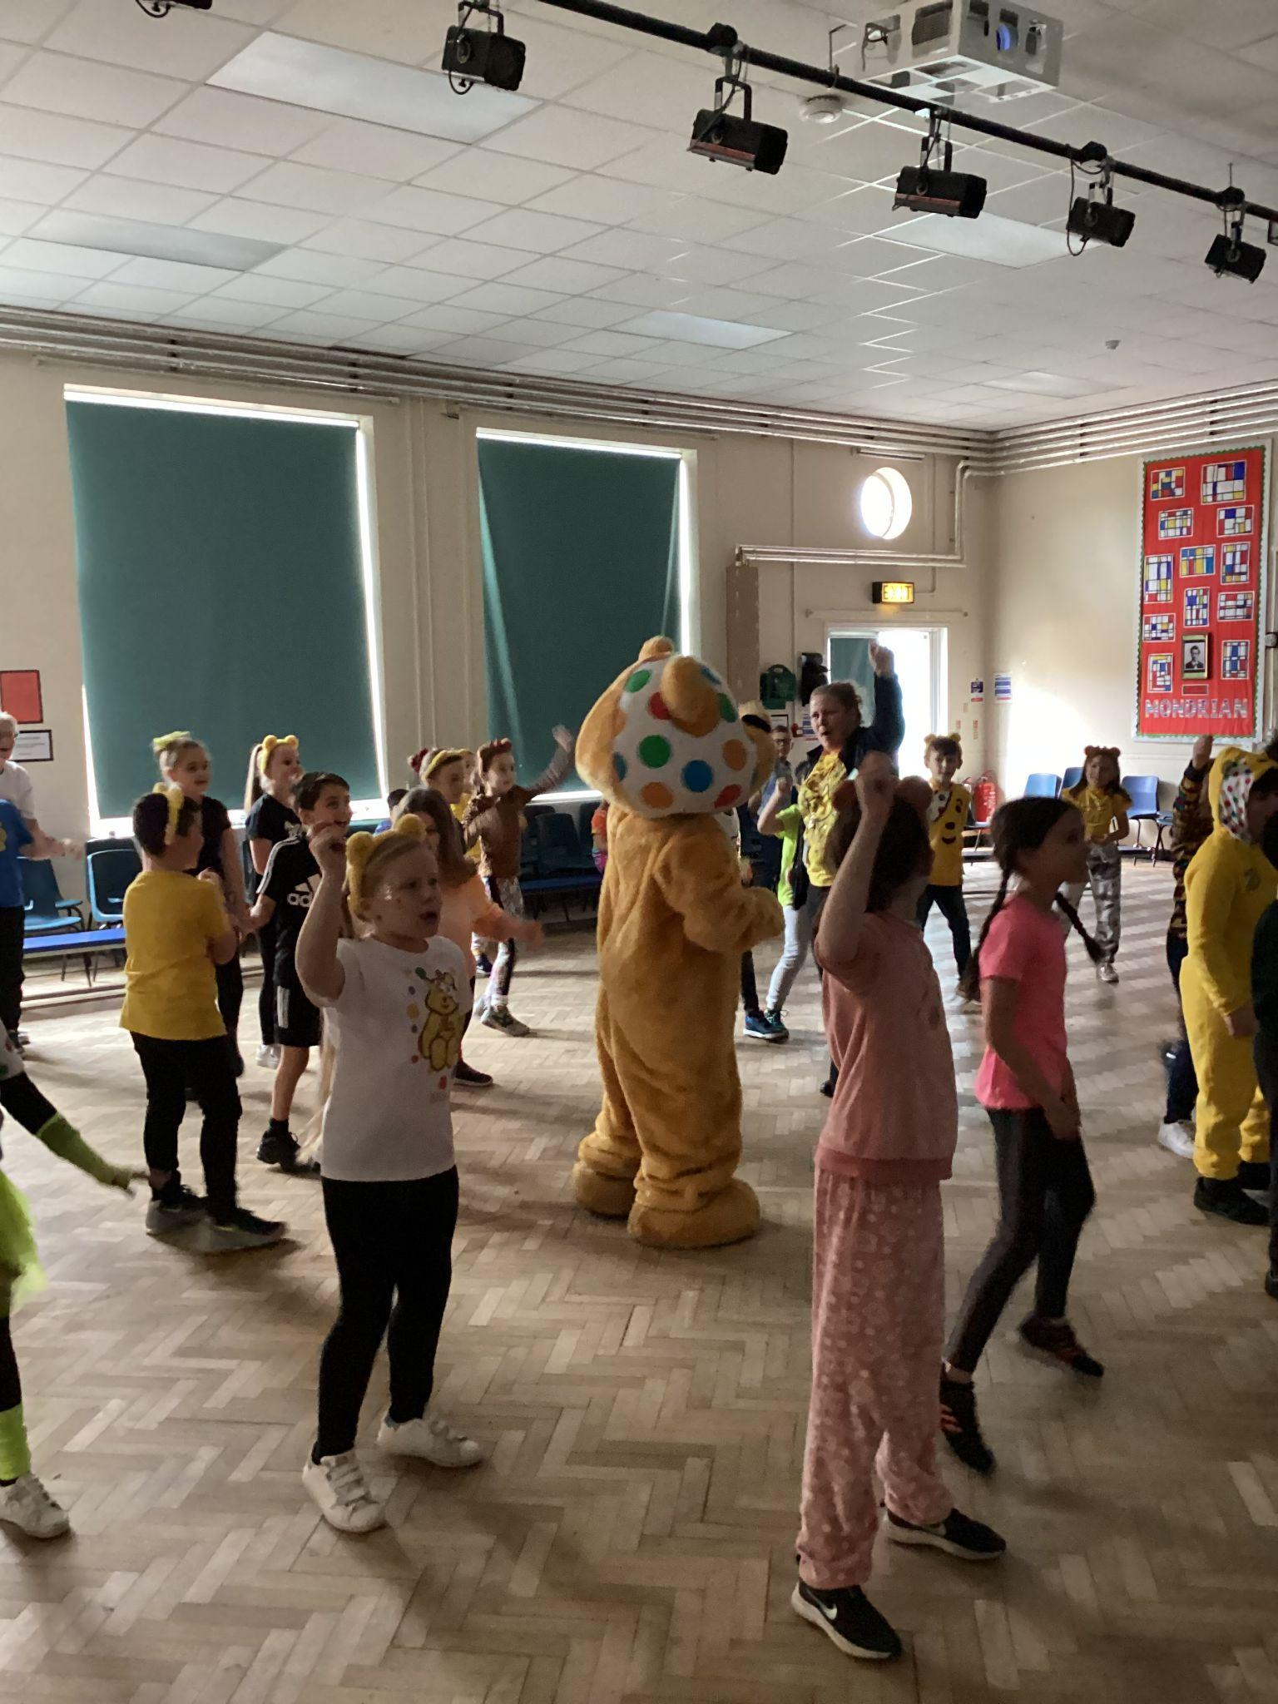
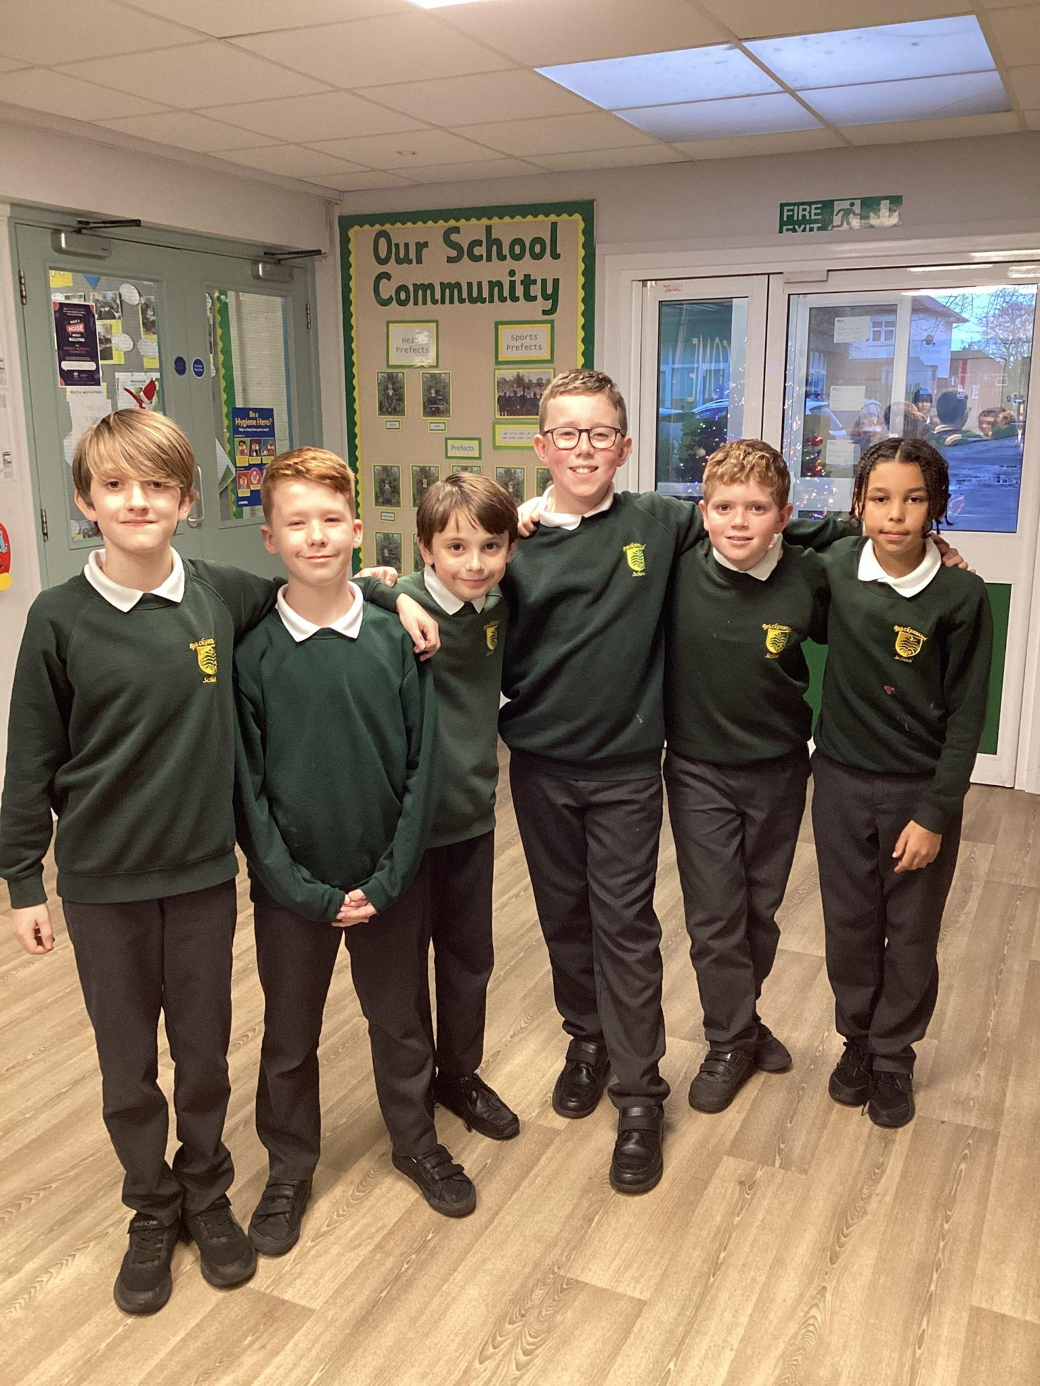
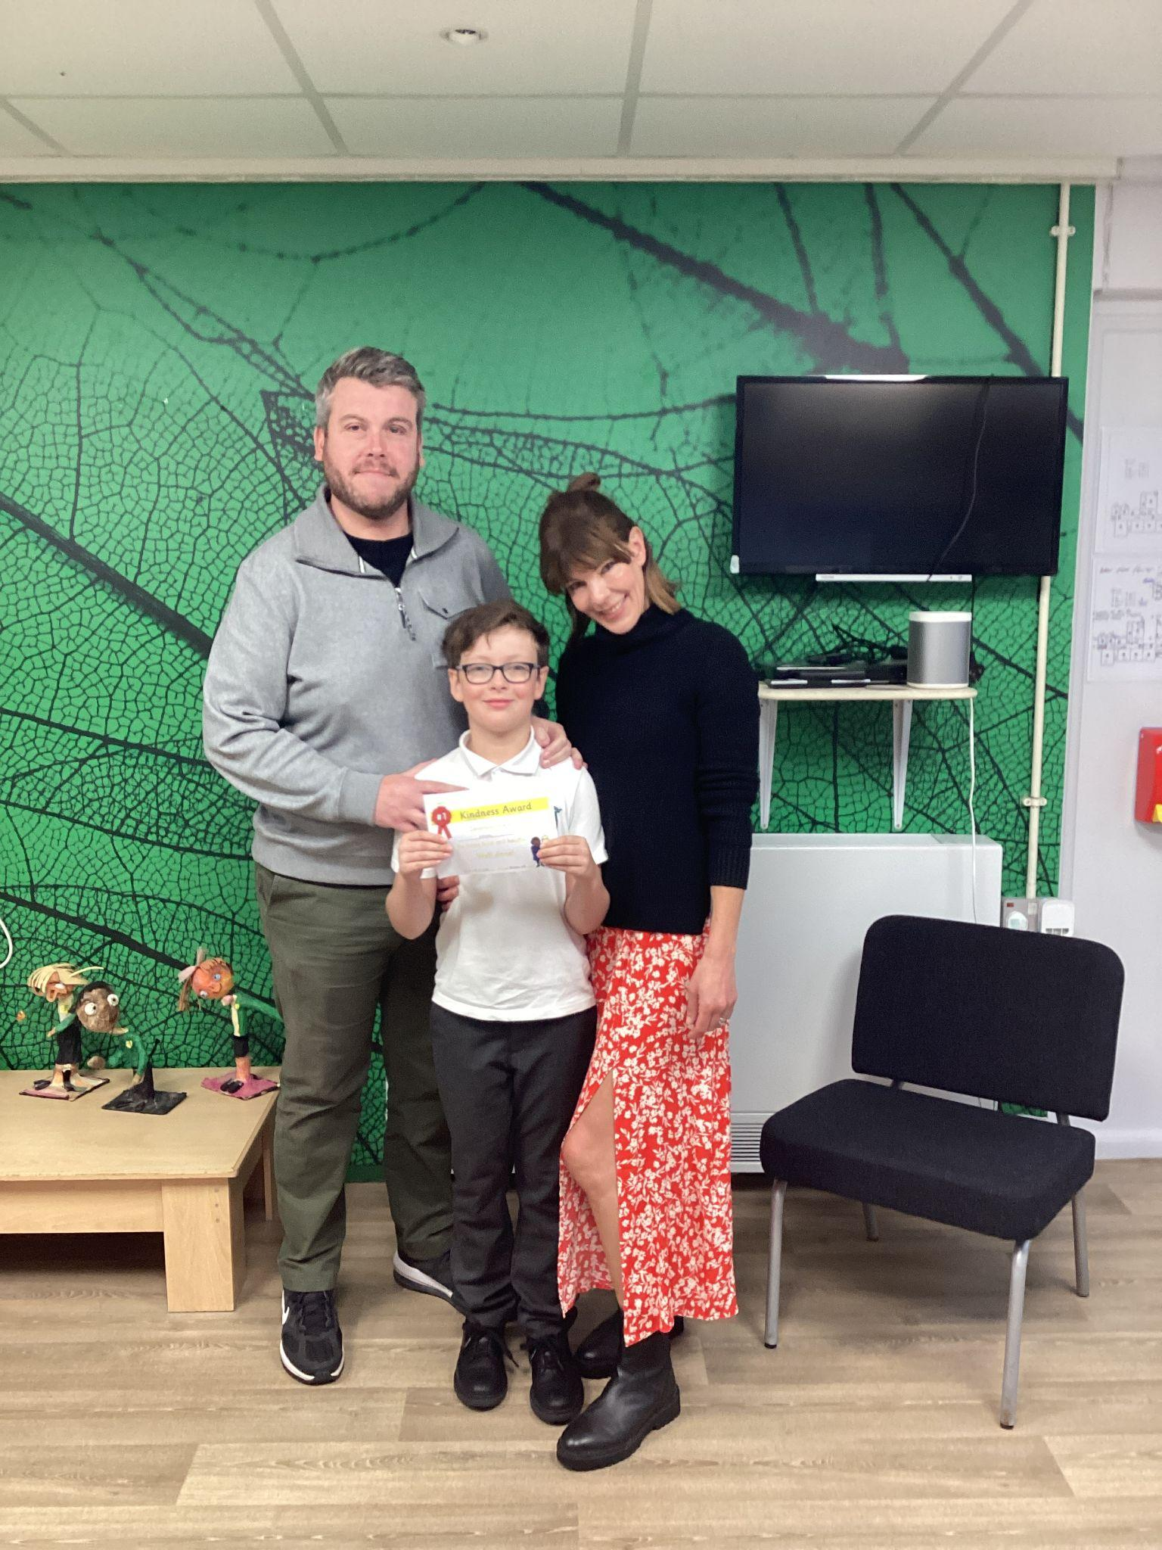
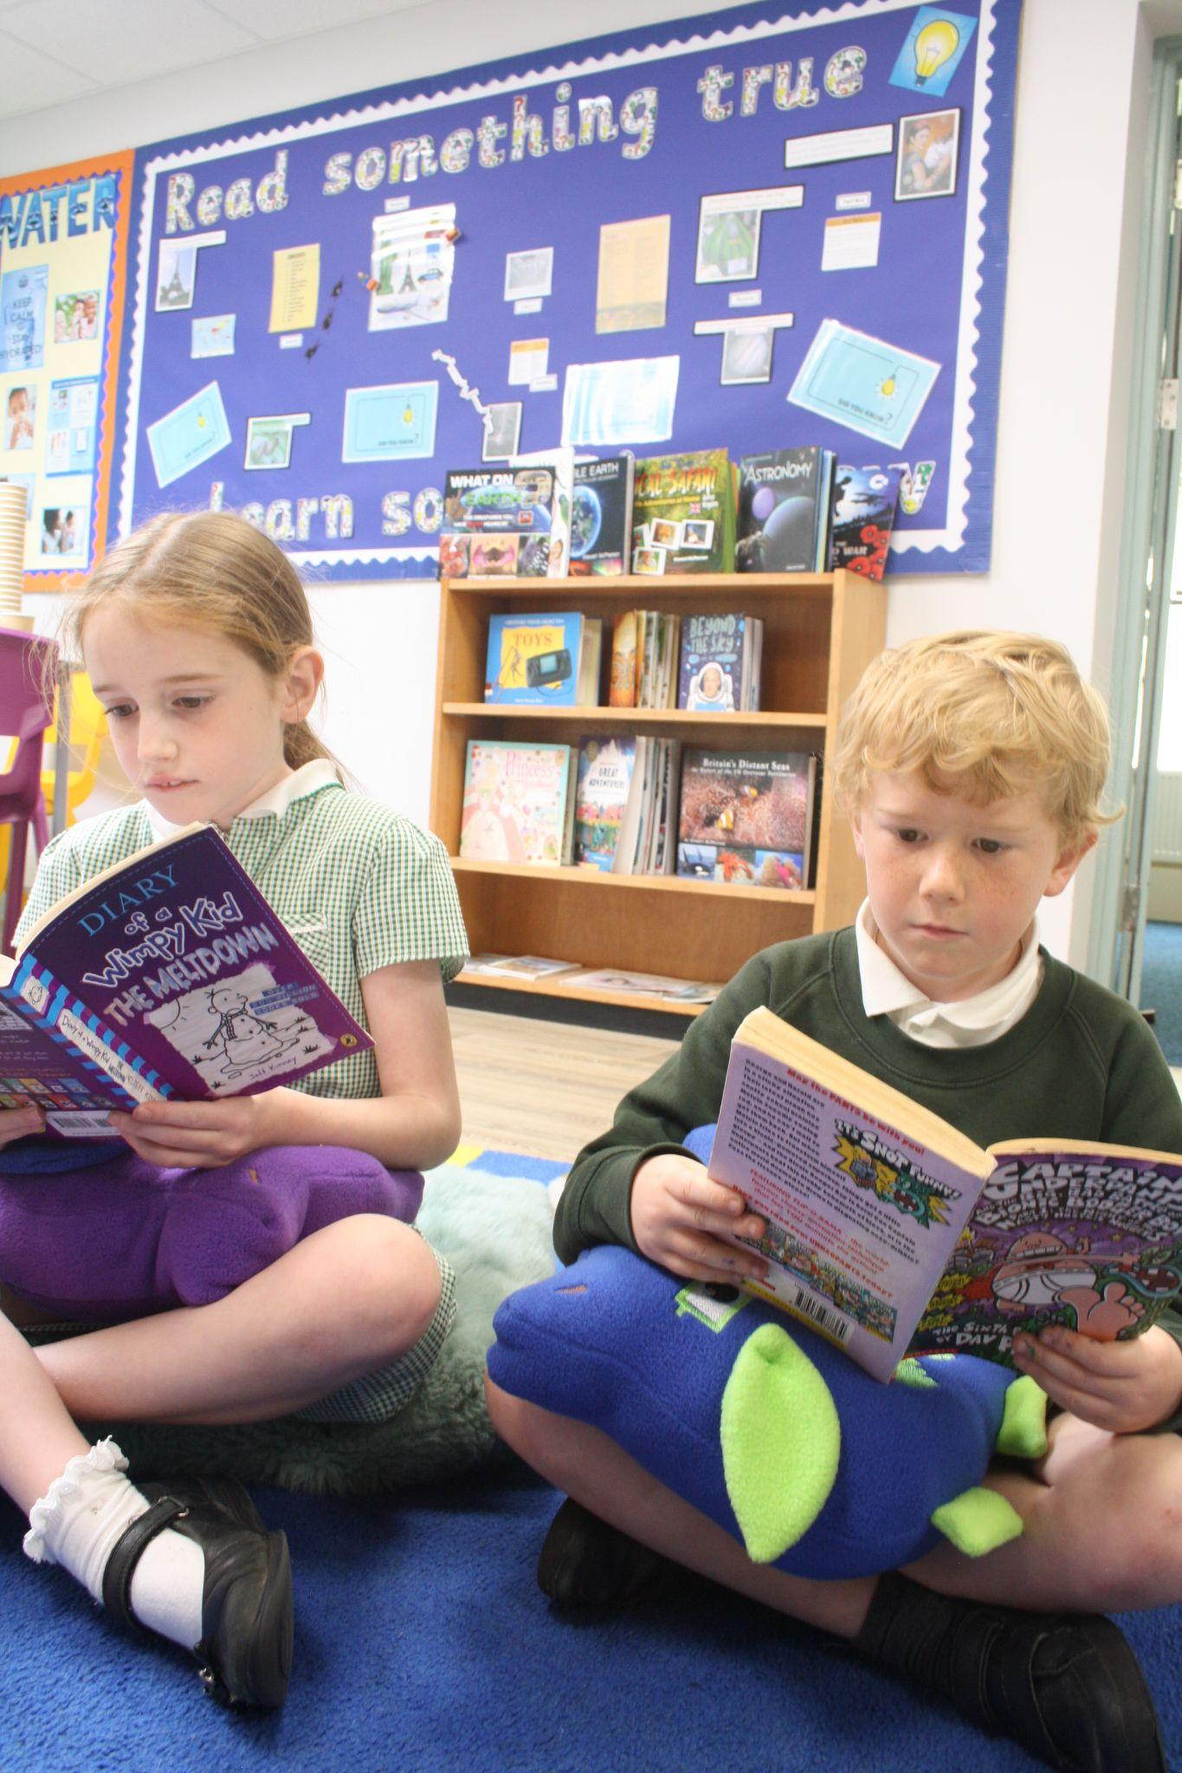

Slide 8
Curriculum Enrichment opportunities
Rock Steady
Celebration Assemblies
Forest School
Friendship Friday’s
Mental Health and Well-being sessions - MHST
Lunchtime Provision - Coach, clubs, sports games, play leaders, Quiet club.
Oak Trees MAT Curriculum days e.g. Environment Day
Charity events e.g. MacMillan coffee morning

Slide 9
Extra-Curricular Activities
We offer a wide range of extra-curricular activities, led by the teachers, teaching assistants and some outside agencies during lunchtimes, before and after school.
Sporting clubs, football, athletics, dance, tag rugby, netball, hockey, cross-country, girl squad.
Drama, Science, Cookery, Choir, Arts and Craft Club, community club, debate club, Maths club
Sports events and competitions across the MAT and Sports Day annually.

Slide 10
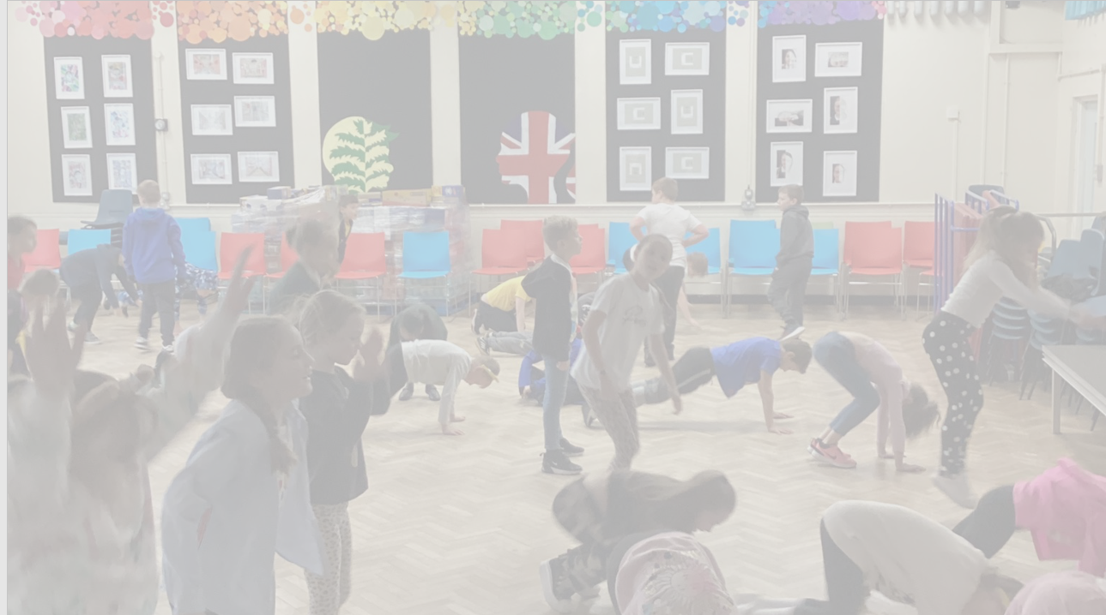
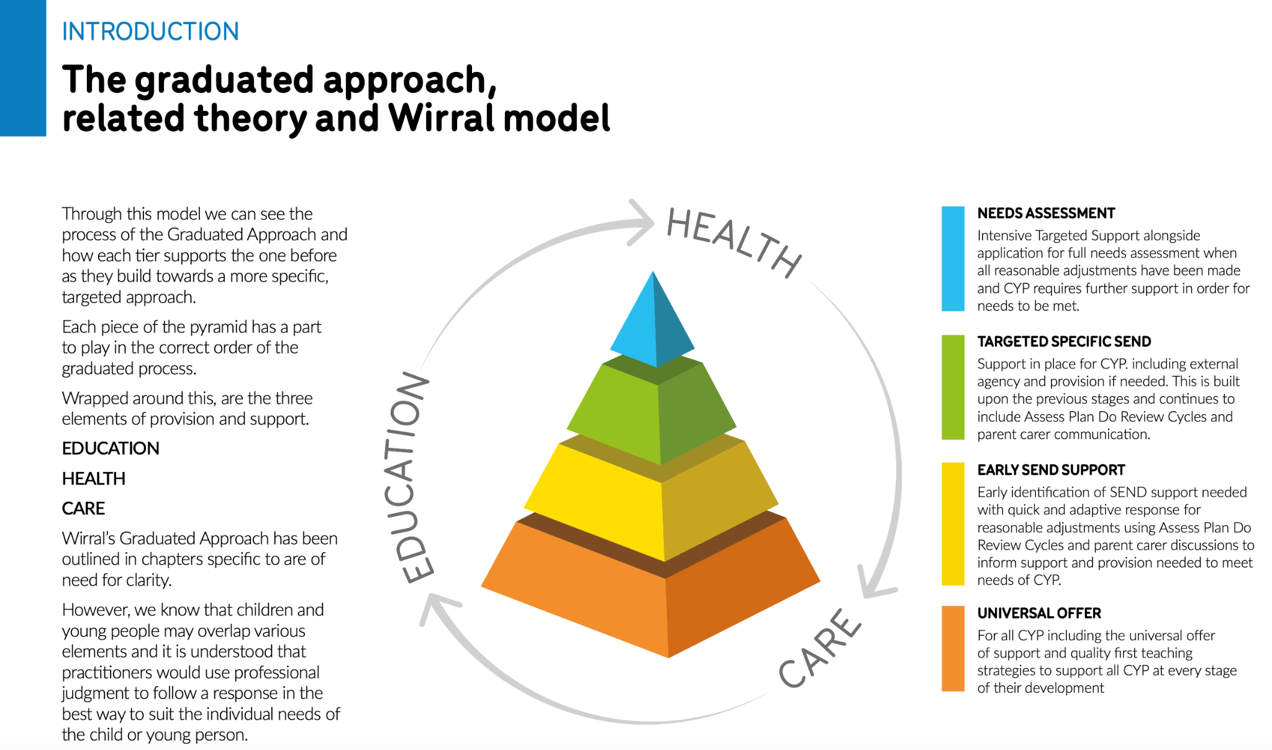
SEND at Brackenwood Juniors
Tier 1 - Quality first teaching
Active lessons
Concrete resources
Kagan structures
Seating plans
Visual timetable
Calm environments
Reasonable adjustments
Tom Sherrington pedagogy
Tier 2 - Support plan - help that goes above and beyond what is given within class through quality first teaching
Phonics interventions
Sensory Circuits
Breakfast Club
Quiet Club
Maths interventions
Motor skills
External agencies

Slide 11
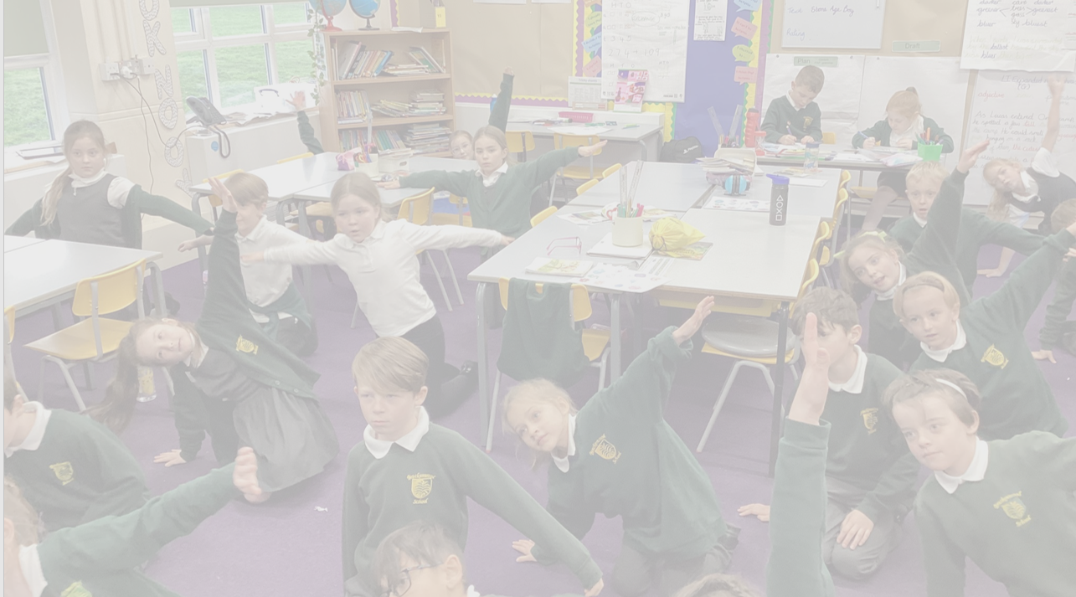
SEND at Brackenwood Juniors
Tier 3 - Short term funding through IPFA - Support plan but with send needs identified that need more assistance than tier 2
All of tier 2 but expected to be longer term
Outreach from specialist provision
External agency advice - ASC Team etc.
Shorter term (6 terms)
Tier 4 - Apply for EHCP
External support
Internal support expected to be needed for more than 6 terms
Parents wishing for their child to attend specialist provision
External Agency Involvement
0-19 referral for ASC, ADHD and dyspraxia
SENAAT
SALT
MHST/CAMH
Occupational Therapy

Slide 12

SEND Transition Plans 2024
Ms Balmer and Mrs Thomas regular meetings since Nov 23
Ms Balmer and support staff visiting BIS to look at provision in place
Ms Balmer, Mrs Thomas, Yr 2 and Yr 3 teachers completing full handover meetings
Ms Balmer and Mrs Thomas drop ins in Yr 2 classes
Parents meetings at BIS
Headteacher and SENCO meetings with all parents at BJS
Transitions day
Enhances transition visits
Mirroring classroom set up/ provision for Aut 1
Yr 3 teachers visiting BIS in Summer Term

Slide 13
This year we will be introducing Headteacher and Assistant Headteacher/SENCO parent consultations and would like to invite parents of all of our new Year 3 children to have a 1-1 meeting with either myself or Ms Balmer who leads on Year 3 and is also our SENCO. It is a perfect opportunity for you to tell us all about your little one before they start with us in September.
This will be taking place on Tuesday 26th March 12:30pm - 3:30pm and on Wednesday 27th March 9.30am-3:30pm.
These consultations will be face to face to get to know you better. Annual parent consultations usually are a hybrid model to accommodate all parents.
In addition, there will be a Year 3 welcome evening in July for opportunities to meet your child's new teacher and in September will also have settling in meetings/phone calls with the Year 3 teachers.
.

Slide 14
Transition support
Transition days - Confirm Dates when Y2’s come up to Juniors
Year 2 have extra visits to the junior school and work with the Year 3’s for afternoons, completing activities.
Year 2 pupils come and watch the Year 3 Harvest Assembly and the Year 6 production in the Summer Term.
Year 3 teachers visit the infant school and read a story to the Year 2 pupils.
Play Leaders.
Y6/Y3 – Brackenwood Buddies.
First week - adjust the provision - Enter through the front door, greeted by their teacher and go straight into the hall. Early lunchtimes and opportunities for Year 6 Buddies to help them.
Extensive handovers between Year 2 and 3 teachers.

Slide 15
Transition Timeline
January – Year 2 meeting for parents and information packs
SENDCO’s meet to discuss pupils requiring additional support (SEND register, PFAs, EHCPs) - Ongoing throughout the year.
March 26th/27th - Headteacher and Assistant Headteacher parent consultations.
May - Year 2/3 teachers arrange at least 2 visits to the junior school for Year 2 – These are planned in June and are detailed on transition documents.
June - Headteachers from Infant/Junior schools meet to discuss assessment data.
June/July – increased transition arrangements actioned for pupils with SEND/pastoral needs.
July – Welcome to Year 3 meeting for parents.

Slide 16
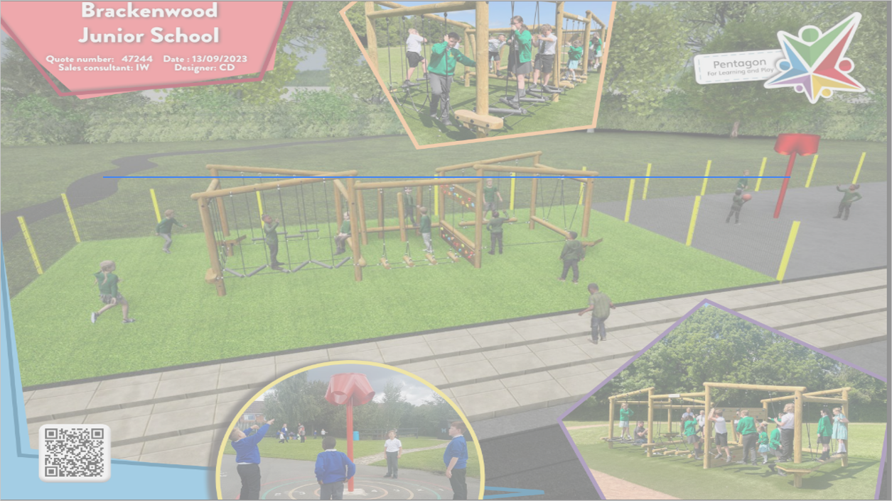
Parents in Partnership
BFG – Brackenwood Fundraising
Group
Currently fundraising to develop our playground.
Support extra provision for school through a range of fundraising events
Frozen Fridays
Movie Nights
Christmas and Summer Fair
Refreshments at Sports Day, the Reading and Anti-bullying workshop as well as other events
‘Break the Rules’ – pupil events
School Discos

Slide 17
Parents in Partnership
Open door policy
Home school communication – via letters, twitter, website, newsletters, telephone calls, celebration assemblies
Staff on the gates morning and on the playground after school
Annual Welcome meetings (July)
Parents Evenings and Formal Summer Term report
Parents Association (BFG)
Parent Supporters – readers, trips, curriculum workshops

Slide 18
Before and After school
We have a before and after school club called Charley’s Childcare, which is privately run – operates from the canteen area and access to outdoor space as well as trips during the school holidays
Details are on our website with email address
Facebook page

Slide 19
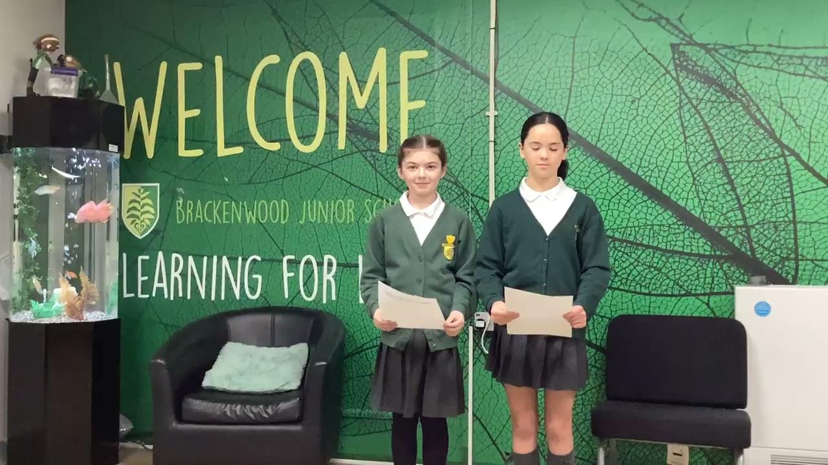

Slide 20

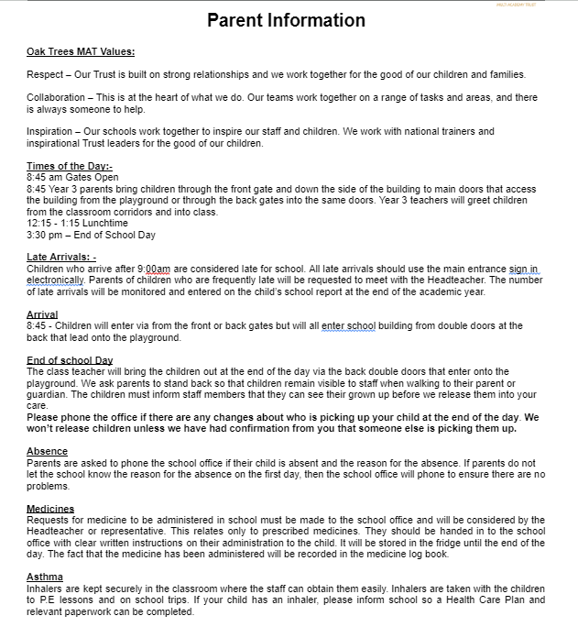
Information Packs
Admission Forms including medical information
Supporting the transition
Uniform Information
Responsible Internet Use
Home School Agreement
Free School Meal eligibility

Slide 21
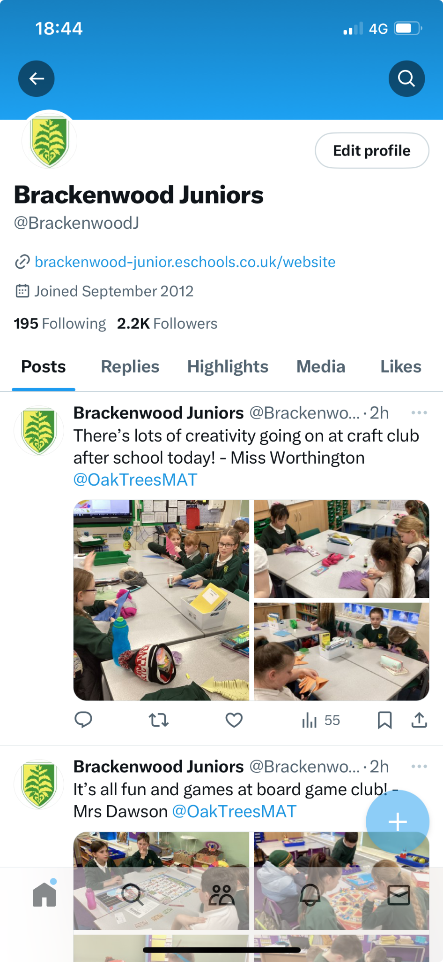
More Information or Questions
Website https://brackenwood-junior.eschools.co.uk/web
Phone school office 0151 608 3001 or email schooloffice@brackenwood-junior.wirral.sch.uk
Follow us on Brackenwood Junior Twitter @BrackenwoodJ
Please contact the school if you have specific questions or want to know more information before your child joins us in September

Slide 22
Any questions?

